Slide 1
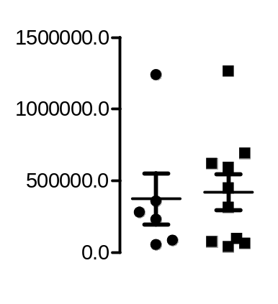
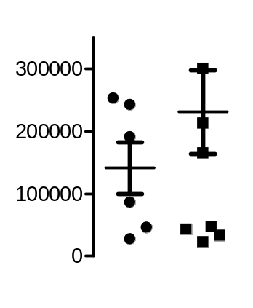
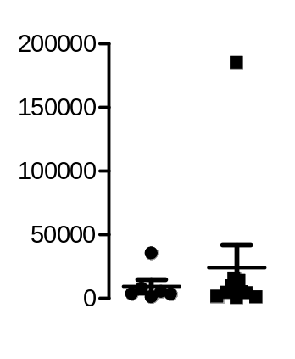
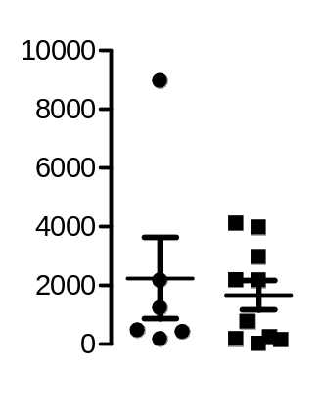
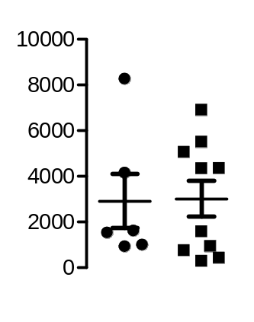
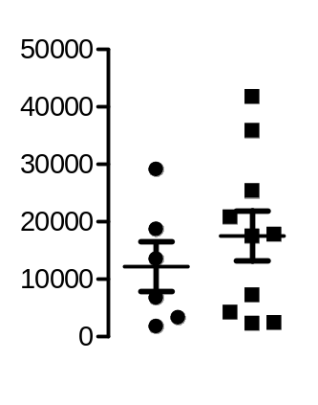
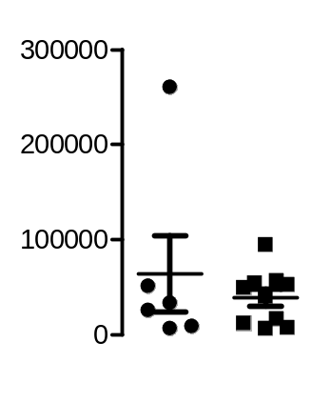
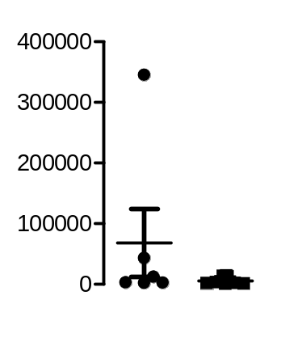
A
CD45+ cells
Macrophages
Neutrophils
Cells/ g tumor
Cells/ g tumor
Cells/ g tumor
WT
Nox4-/-
WT
Nox4-/-
WT
Nox4-/-
pDC
CD11b+ cDC
NK cells
Cells/ g tumor
Cells/ g tumor
Cells/ g tumor
WT
Nox4-/-
WT
Nox4-/-
WT
Nox4-/-
T cells
Cell type | Wild type | Nox4-/-
CD4+ T cells | 3.2*10⁴ ± 1.9*10⁴ | 1.3*10⁴ ± 0.3*10⁴
CD8+ T cells | 2.5*10⁴ ± 1.4*10⁴ | 1.8*10⁴ ± 0.4*10⁴
CD4- CD8- NK T cells | 0.3*10⁴ ± 0.1*10⁴ | 0.5*10⁴ ± 0.1*10⁴
Cells/ g tumor
WT
Nox4-/-
B cells
Cells/ g tumor
WT
Nox4-/-
Supplemental Figure 1. FACS analysis of tumor tissue revealed only a tendency for differences in B cells within Nox4-deficient tumors.
(A) Fibro sarcoma tissue of wild type and Nox4-/- mice was analyzed for cell composition with FACS using specific antibodies for cells indicated. Table contains the different T cell populations in cells/g tumor tissue; no statistical differences, (n=6-10).

Slide 2
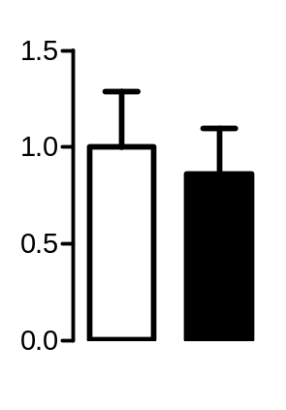
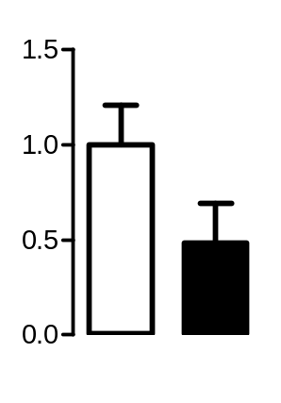
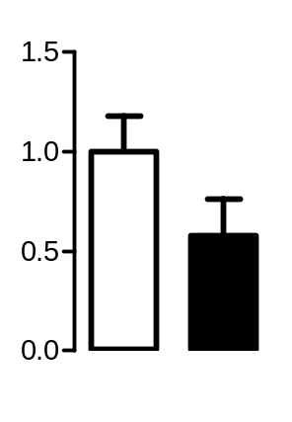
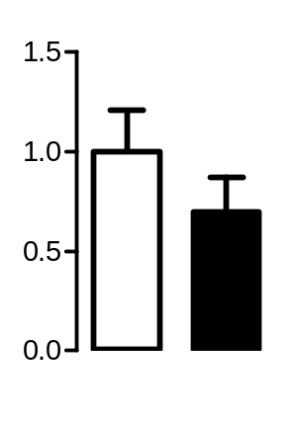
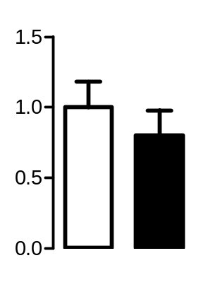
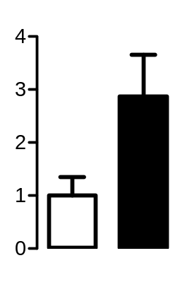
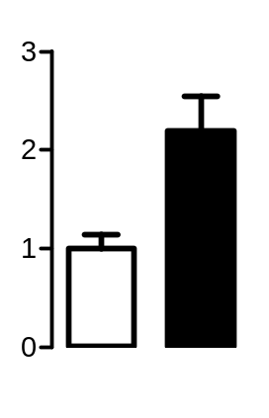
A
iNOS
FIZZ1
Arginase 1
YM1
rel iNOS mRNA expression
rel FIZZ! mRNA expression
rel ARG 1 mRNA expression
rel. YM! mRNA expression
WT
Nox4-/-
WT
Nox4-/-
WT
Nox4-/-
WT
Nox4-/-
CD163
MMP9
Collagen I
Collagen III
*
rel CD163 mRNA expression
rel MMP-9 mRNA expression
rel ColI mRNA expression
rel ColIII mRNA expression
WT
Nox4-/-
WT
Nox4-/-
WT
Nox4-/-
WT
Nox4-/-
Supplemental Figure 2. Tumor tissue was analyzed for different inflammatory and anti-inflammatory markers.
(A) Fibro sarcoma tissue of wildtype and Nox4-/- mice was analyzed for pro-inflammatory marker iNOSand CD163, anti-inflammatory markers FIZZ1, Arginase 1 and YM1, as well as tissue remodelling markers MMP9, Collagen I and III with RT-qPCR; *p< 0.05, (n=6-10).

Slide 3
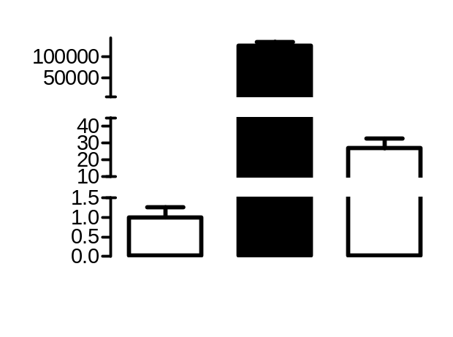
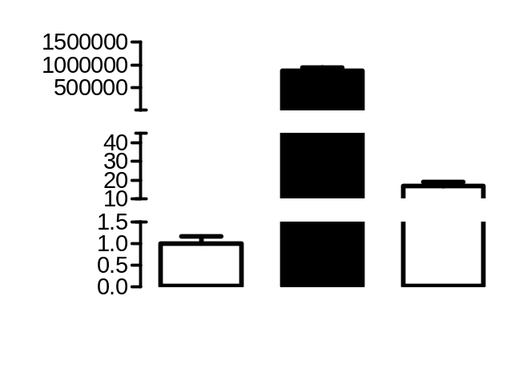
A
murine macrophages
B
human macrophages
rel. mRNA expression
rel. mRNA expression
Nox1
Nox2
Nox4
Nox1
Nox2
Nox4
CT:34
CT:17
CT:29
CT:37
CT:17
CT:32
Supplemental Figure 3. NADPH oxidase expression in isolated murine and human macrophages.
Nox1, Nox2 and Nox4 expression was determined by RT-qPCR in isolated murine (A) and human (B) macrophages and corresponding CT values were included, (n=3).

Slide 4
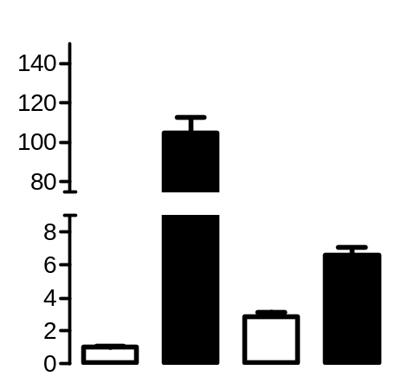
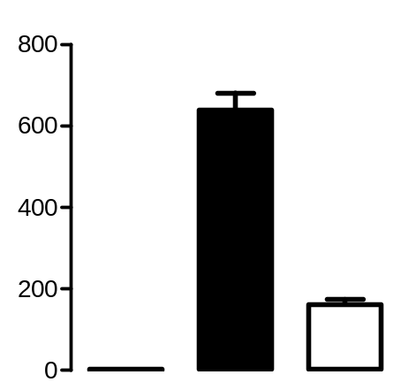
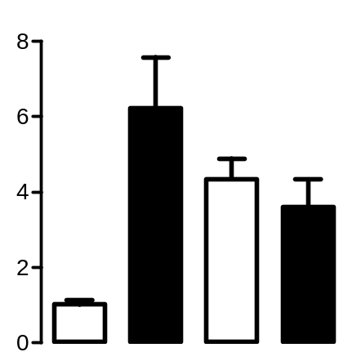
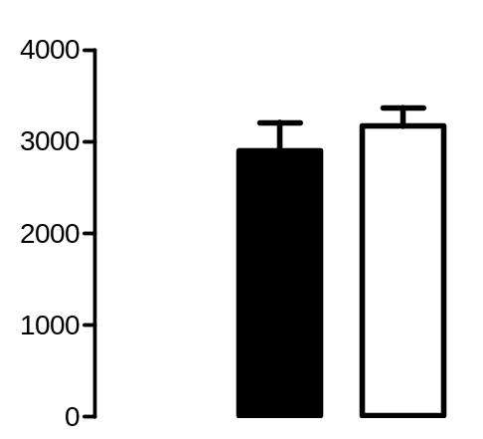
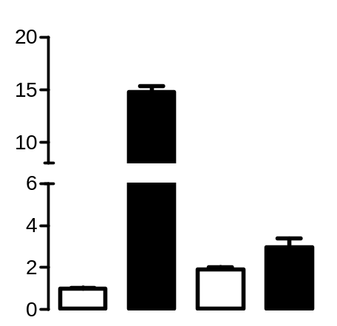
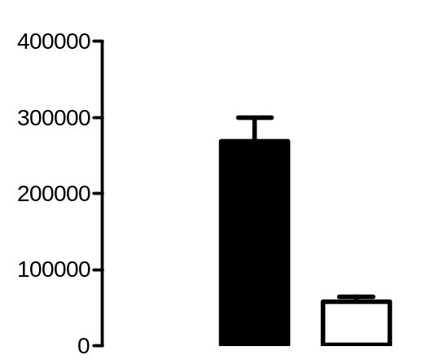
A
ARG1 mRNA expression
B
TNFα mRNA expression
*
*
rel. ARG1 mRNA expression
rel. TNFα mRNA expression
*
*
*
CTL
M
(IL4+IL13)
H₂O₂
PMA /
PEG-SOD
CTL
M
(LPS+IFNγ)
PEG-Cat
FIZZ1 mRNA expression
IL1β mRNA expression
*
*
*
*
*
rel. FIZZ1 mRNA expression
rel. Il1β mRNA expression
CTL
M
(IL4+IL13)
H₂O₂
PMA /
PEG-SOD
CTL
M
(LPS+IFNγ)
PEG-Cat
YM1 mRNA expression
iNOS mRNA expression
*
*
rel. YM1 mRNA expression
rel. iNOS mRNA expression
*
*
*
CTL
M
(IL4+IL13)
H₂O₂
PMA /
PEG-SOD
CTL
M
(LPS+IFNγ)
PEG-Cat
Supplemental Figure 4: H₂O₂ mediates polarization of macrophages without cytokine stimulation.
(A) WT macrophages were treated with basal medium or IL4 and IL13 to polarize. For polarization without cytokines cells were treated with 5µM H₂O₂ or PEG-SOD (50U/ml) and PMA (100nM) for 4h and polarization markers ARG1, FIZZ1 and YM1 were quantified with RT-qPCR, *p< 0.05, (n=6). (B) WT macrophages were treated with basal medium or LPS and IFNγ or PEG-Catalase (500U/ml) for 4h to polarize, followed by subsequent analysis of polarization markers TNFα, IL1β and iNOS; *p< 0.05 ,(n=3).

Slide 5
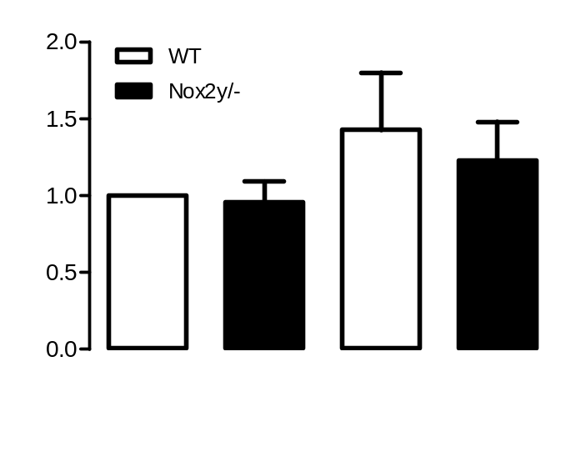
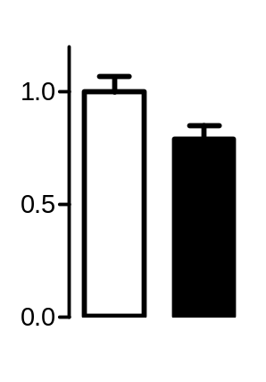
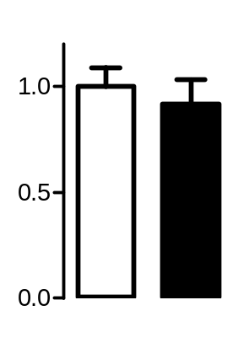
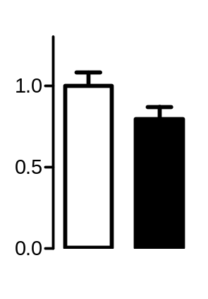
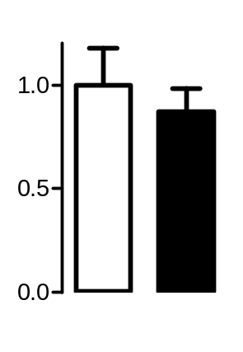
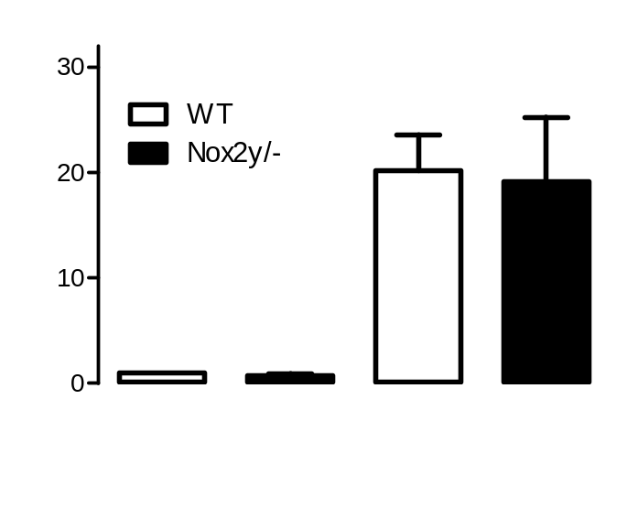
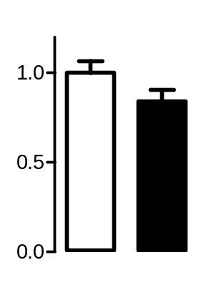
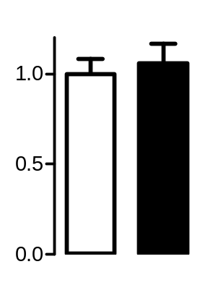
A
B
C
M(LPS+IFNγ) marker
M(IL4+IL13) marker
YM1 protein expression
TNFα
Arginase 1
*
YM1/β-Actin
rel. TNFα mRNA expression
rel. ARG1 mRNA expression
WT
Nox2y/-
WT
Nox2y/-
45
YM1
42
β-Actin
IL1β
YM1
WT
Nox2y/-
WT
Nox2y/-
*
M(LPS + IFNγ)
M(IL4 + IL13)
rel. IL1β mRNA expression
rel. YM1 mRNA expression
D
p-STAT6/STAT6 protein expression
#
#
WT
Nox2y/-
WT
Nox2y/-
pSTAT6/STAT6
iNOS
FIZZ1
*
100
pSTAT6
rel. iNOS mRNA expression
rel. FIZZ mRNA expression
STAT6
100
42
β-Actin
WT
Nox2y/-
WT
Nox2y/-
WT
Nox2y/-
WT
Nox2y/-
M(LPS + IFNγ)
M(IL4 + IL13)
Supplemental Figure 5. Nox2 knockout decreases M(LPS+IFNγ) polarization of macrophages.
The specific M(LPS+IFNγ) markers IL1β, TNFα and iNOS (A) and specific M(IL4+IL13) markers Arginase 1, YM1 and FIZZ1 (B) were quantified by RT-qPCR after stimulation with cytokines polarizing the bone marrow-derived macrophages from Nox2KO/C57Bl6J mice to M(LPS+IFNγ) or M2(IL4+IL13) phenotype. Protein expression of the M(IL4+IL13) marker YM-1 (C) and the ratio of pSTAT6 to STAT6 (D) as determined by Western Blot; *p< 0.05, #p< 0.05 WT/Nox2y/- M(LPS+IFNγ) vs. WT/Nox2y/- M(IL4+IL13), (n=4-8).

Slide 6
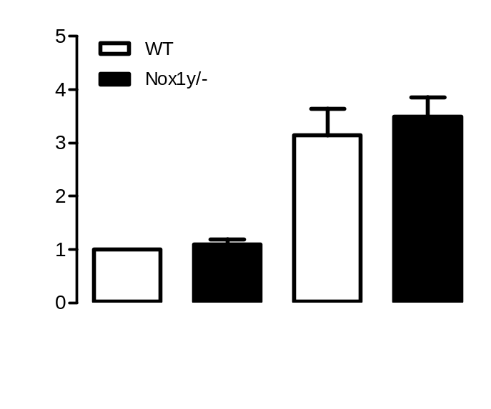
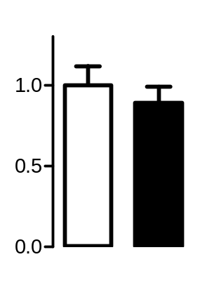
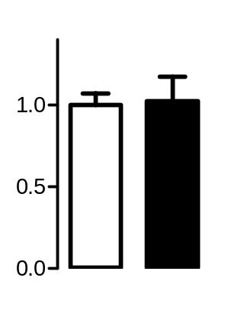
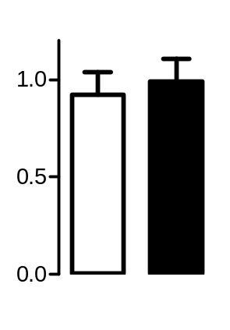
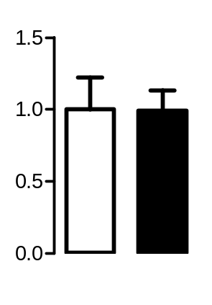
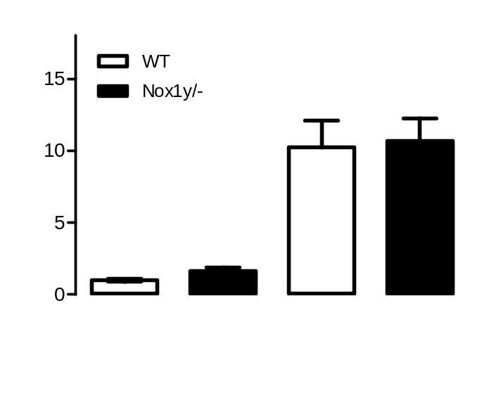
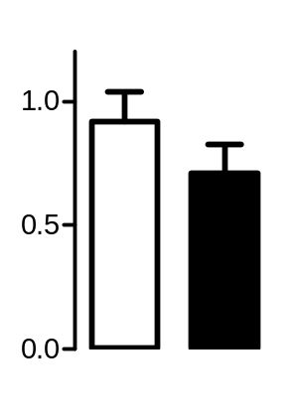
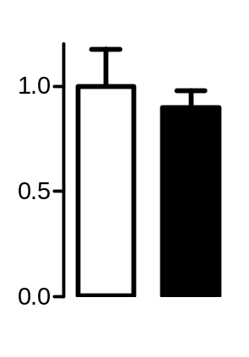
A
B
C
M(LPS+IFNγ) marker
M(IL4+IL13) marker
YM1 protein expression
TNFα
Arginase 1
#
#
rel. TNFα mRNA expression
rel. ARG1 mRNA expression
YM1/β-Actin
WT
Nox1y/-
WT
Nox1y/-
45
YM1
IL1β
42
β-Actin
YM1
WT
Nox1y/-
WT
Nox1y/-
M(LPS + IFNγ)
M(IL4 + IL13)
rel. IL1β mRNA expression
rel. YM1 mRNA expression
D
p-STAT6/STAT6 protein expression
#
#
WT
Nox1y/-
WT
Nox1y/-
pSTAT6/STAT6
iNOS
FIZZ1
100
pSTAT6
rel. iNOS mRNA expression
rel. FIZZ mRNA expression
STAT6
100
42
β-Actin
WT
Nox1y/-
WT
Nox1y/-
WT
Nox1y/-
WT
Nox1y/-
M(LPS + IFNγ)
M(IL4 + IL13)
Supplemental Figure 6: Deficiency in Nox1 does not affect polarization of macrophages.
The specific M(LPS+IFNγ) markers IL1β, TNFα and iNOS (A) and specific M(IL4+IL13) markers Arginase 1, YM1 and FIZZ1 (B) were quantified by RT-qPCR after stimulation with cytokines polarizing the bone marrow-derived macrophages from Nox1KO/C57Bl6J mice to M(LPS+IFNγ) or M2(IL4+IL13) phenotype. Protein expression of the M(IL4+IL13) marker YM1 (C) and the ratio of pSTAT6 to STAT6 (D) as determined by Western Blot; *p< 0.05, #p< 0.05 WT/Nox1y/- M(LPS+IFNγ) vs. WT/Nox1y/- M(IL4+IL13), (n=3-6).

Slide 7
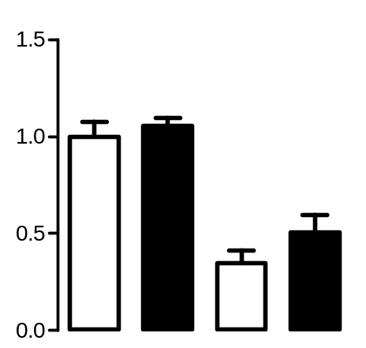
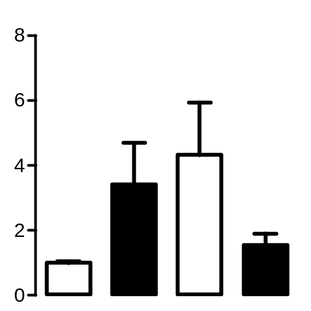
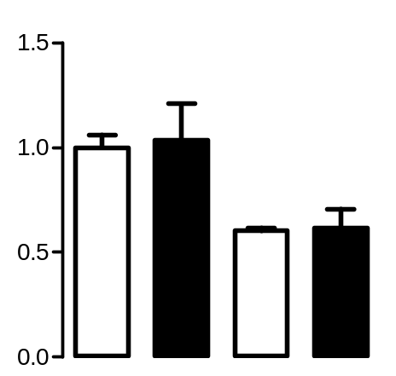
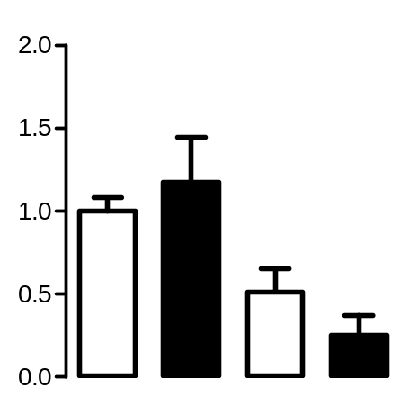
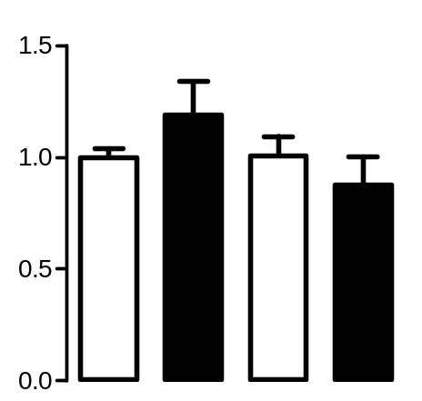
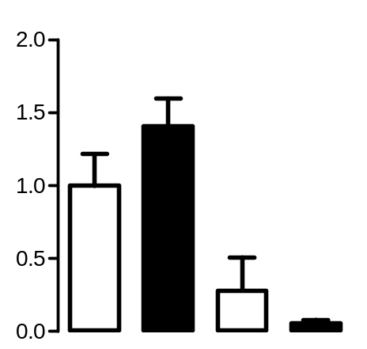
A
SOD1 mRNA expression
B
SOD3 mRNA expression
rel. SOD1 mRNA expression
*
rel. SOD3 mRNA expression
*
WT
Nox4-/-
WT
Nox4-/-
WT
Nox4-/-
WT
Nox4-/-
M(LPS+IFNγ)
M(IL4+IL13)
M(LPS+IFNγ)
M(IL4+IL13)
C
p40phox mRNA expression
D
p47phox mRNA expression
rel. p40phox mRNA expression
*
rel. p47phox mRNA expression
*
*
WT
Nox4-/-
WT
Nox4-/-
WT
Nox4-/-
WT
Nox4-/-
M(LPS+IFNγ)
M(IL4+IL13)
M(LPS+IFNγ)
M(IL4+IL13)
E
p67pox mRNA expression
F
Nox1 mRNA expression
rel. p67phox mRNA expression
rel. Nox1 mRNA expression
*
WT
Nox4-/-
WT
Nox4-/-
WT
Nox4-/-
WT
Nox4-/-
M(LPS+IFNγ)
M(IL4+IL13)
M(LPS+IFNγ)
M(IL4+IL13)
Supplemental Figure 7: SOD and Nox2 cytosolic subunits expression in WT and Nox4-deficient macrophages.
SOD1 (A) and SOD3 (B) expression was analyzed in WT and Nox4-/- M(LPS+IFNγ) and M(IL4+IL13) polarized macrophages byRT-qPCR. Expression of cytosolic Nox2 subunits (C:p40phox, D:p47phox, E:p67phox) and Nox1 (F) was analyzed in WT and Nox4-/- M(LPS+IFNγ) and M(IL4+Il13) polarized macrophages using RT-qPCR, *p<0.05 WT/Nox4-/- M(LPS+IFNγ) vs. WT/Nox4-/- M(IL4+IL13), (n=5-8).

Slide 8
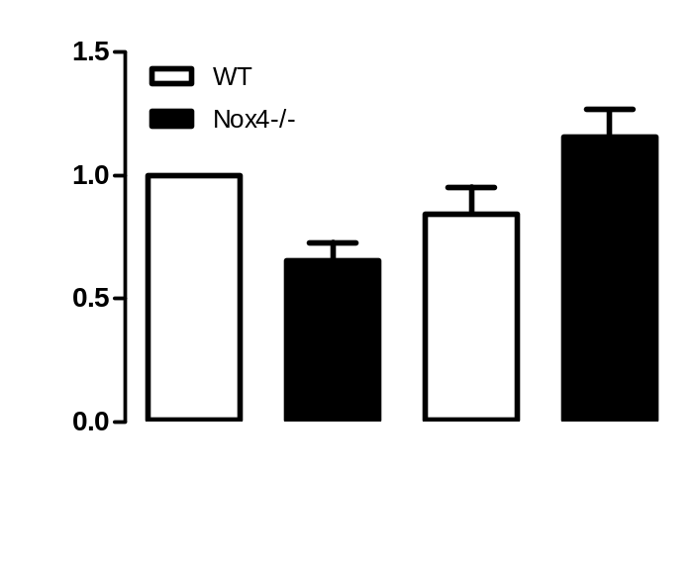
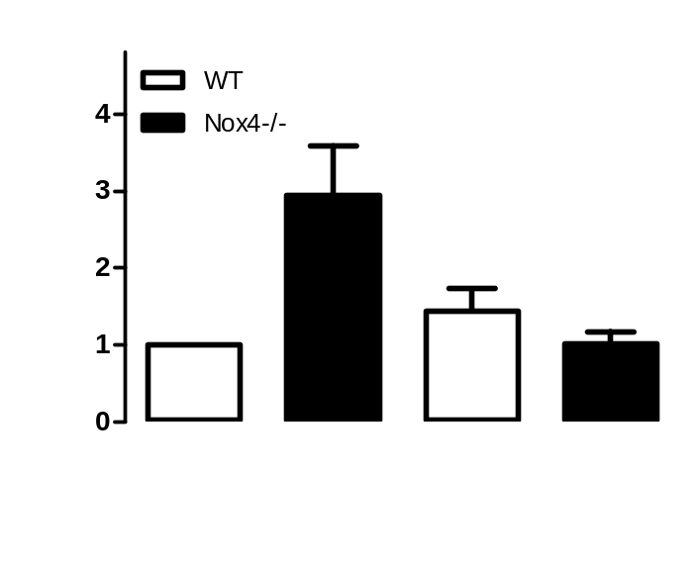
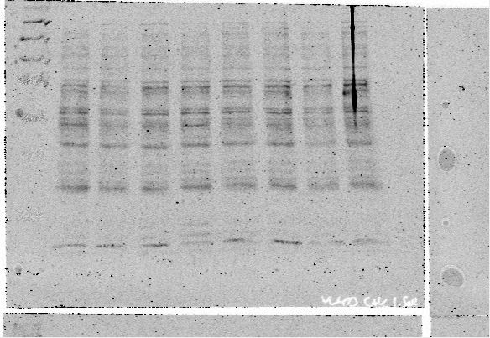
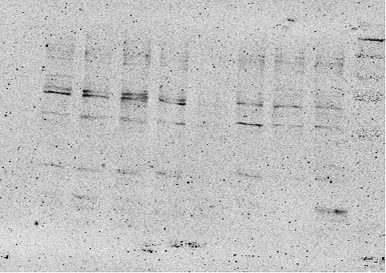
A
Cytosolic fraction p65
B
Nuclear extract p65
#
*
p65/β-Tubulin
*
p65/TOPO
#
65
p65
65
p65
55
β-
Tubulin
100
TOPO
WT
Nox4-/-
WT
Nox4-/-
WT
Nox4-/-
WT
Nox4-/-
CTL
NFκB inhibitor
CTL
NFκB inhibitor
Supplemental Figure 8:
NFκB inhibition prevents p65 translocation into the nucleus in M(LPS+IFNγ) polarized macrophages of Nox4-/-.
P65 expression in cytosol (A) and nucleus (B) was assessed with Western Blot after M(LPS+IFNγ) polarization with and without treatment of NFκB inhibitor (30ng/ml, 1h pretreament before M(LPS+IFNγ) polarization); *p<0.05 WT vs. Nox4-/-, #p< 0.05 CTL vs. NFκB inhibitor, (n=3-8). TOPO: topoisomerase I

Slide 9
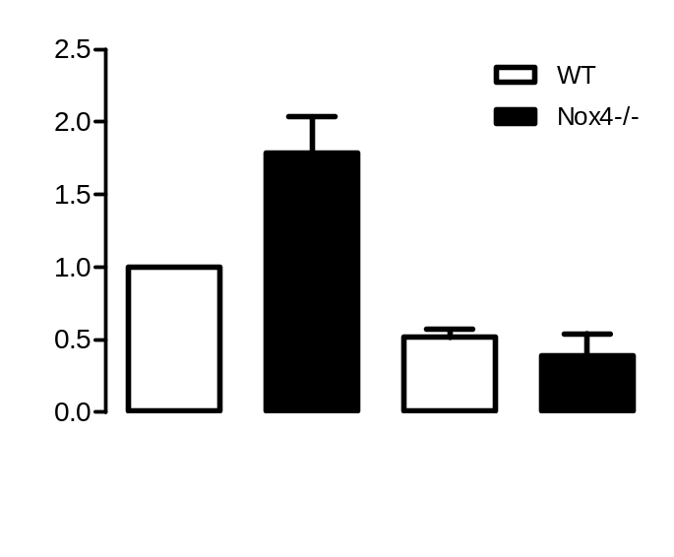


A
YY1 protein expression
B
pSTAT1/STAT1 protein expression
*
YY1/β-Actin
pSTAT1/STAT1
#
#
#
#
68
YY1
pSTAT1
110
42
β-Actin
STAT1
WT
Nox4-/-
110
WT
Nox4-/-
42
β-Actin
M(LPS + IFNγ)
M(IL4 + IL13)
WT
Nox4-/-
WT
Nox4-/-
M(LPS + IFNγ)
M(IL4 + IL13)
Supplemental Figure 9: YY1 is increased in Nox4-deficient macrophages after M(LPS+IFNγ) polarization.
(A) YY1 expression was determined by Western Blot after polarization of WT and Nox4-/- macrophages. (B) Phosphorylation of pSTAT1 and total STAT1 quantified by Western Blot in M(LPS+IFNγ) and M(Il4+Il13) polarized macrophages of WT and Nox4-deficient animals; *p< 0.05 WT vs. Nox4-/-, #p< 0.05 WT/Nox4-/- M(LPS+IFNγ) vs. WT/Nox4-/- M(IL4+IL13), (n=3-5).

Slide 10



A
TNFα mRNA expression
B
IL1β mRNA expression
#
#
*
*
#
#
rel. TNFα mRNA expression
rel. IL1β mRNA expression
DMSO
GKT
DMSO
GKT
DMSO
GKT
DMSO
GKT
CTL
M(LPS + IFNγ)
CTL
M(LPS + IFNγ)
C
iNOS mRNA expression
*
#
#
rel. iNOS mRNA expression
*
DMSO
GKT
DMSO
GKT
CTL
M(LPS + IFNγ)
Supplemental Figure 10. Inhibition of Nox4 in Nox2-deficient macrophages elevates M(LPS+IFNγ) polarization in M(LPS+IFNγ) -polarized macrophages.
Nox2-deficient macrophages were treated with Nox4 inhibitor GKT (10µM) 2h prior to cell polarization to M(LPS+IFNγ) or only control medium (CTL). M(LPS+IFNγ) markers TNFγ, IL1β and iNOS were evaluated using RT-qPCR; *p< 0.05 DMSO vs. GKT, #p< 0.05 DMSO/GKT CTL vs. DMSO/GKT M(LPS+IFNγ), (n=3).

