Slide 1
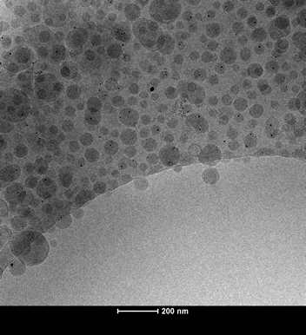
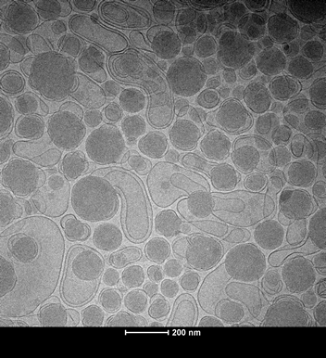
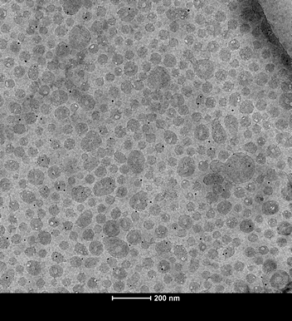
Figure S1
A
B
C
200 nm
200 nm
200 nm
LNP-DBCO
LNP-DBCO,
directly
clicked ligand
LNP, postinserted
ligand-DBCO
Figure S1. Cryo EM analysis of DNA barcode LNPs morphology. CryoEM of different DNA barcode LNPs. (A) DNA barcode LNPs containing 1.5% DMG-PEG(2000) and 0.1% molar ratio DSPE-PEG₍₂₀₀₀₎-DBCO added to the microfluidic mixture. (B) DNA barcode LNPs with ligand-azide directly clicked to DBCO present on the surface of DNA barcode LNPs. (C) DNA barcode LNPs with 0.1% molar ratio DSPE-PEG₍₂₀₀₀₎-triazole-ligand post-inserted after dialysis.

Slide 2
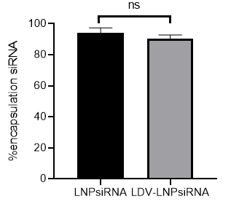
Figure S2
Figure S2. Encapsulation efficiency inside LNPsiRNA before and after post-insertion. Graph showing the encapsulation efficiency before and after post-insertion with LDV-ligand as determined by RiboGreen Assay.*P<0.05, **P<0.01, ***P<0.001, ns non-significant, two-tailed Student’s t-test.

Slide 3
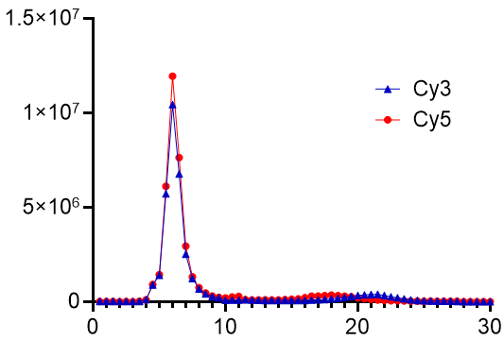
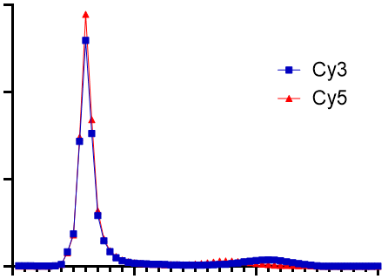
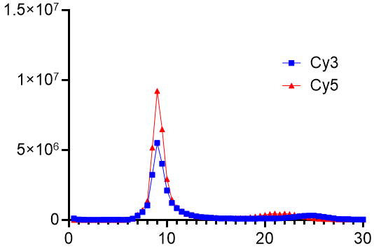
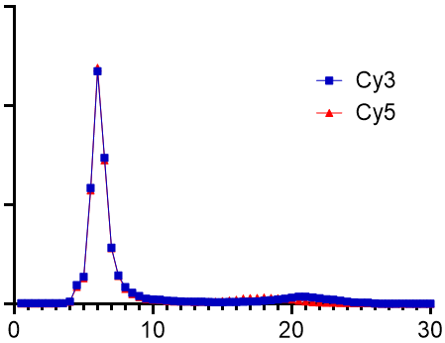
Figure S3
25ºC
35ºC
MFI
45ºC
55ºC
Elution volume (ml)
Figure S3. Repetition of temperature dependence of post-insertion reaction. Graphs showing FPLC elution profiles of LNPs containing Cy5-siRNA after incubation with DSPE-PEG₍₂₀₀₀₎-triazole-Cy3 for 2 hours at different temperatures. Reaction temperatures are indicated at the top of each graph.

Slide 4
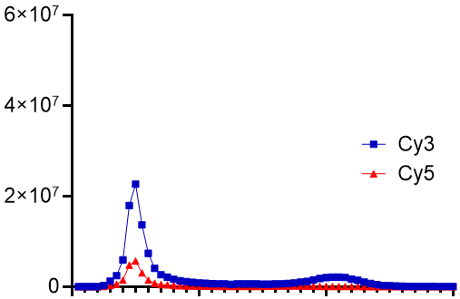
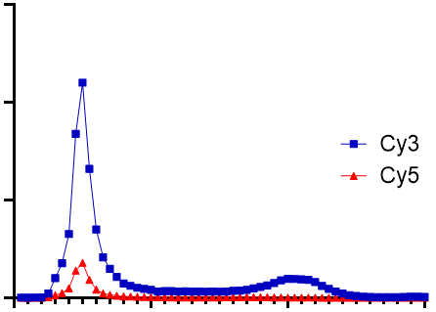
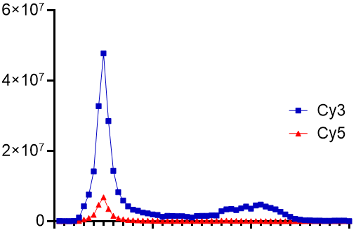
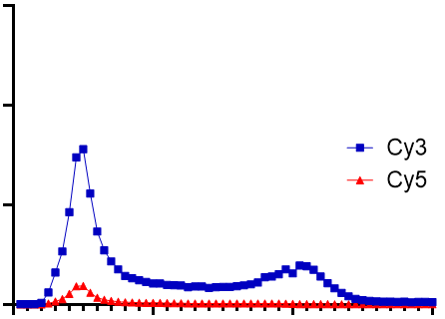
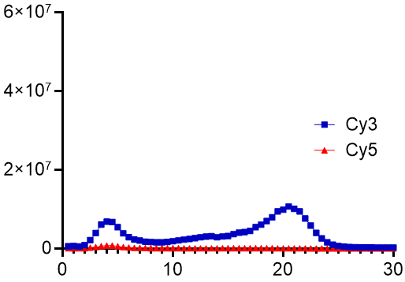
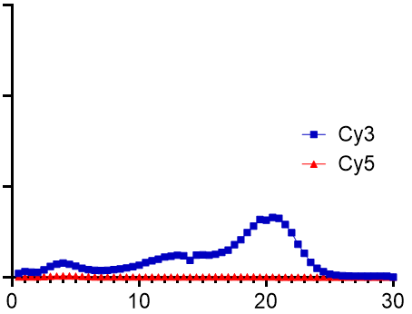
Figure S4A
0.5% PEG
1% PEG
MFI
1.5% PEG
2% PEG
3% PEG
4% PEG
Elution volume (ml)
Figure S4. Post-insertion of PEG plateau as measured by DLS. (A) Graphs showing FPLC elution profiles of LNPs containing Cy5-siRNA after incubation with 0.5%, 1%, 1.5%, 2%, 3% or 4% DSPE-PEG(2000)-triazole-cy3 for 30 min at 45°C. The post-inserted PEG percentages are indicated at the top of each graph.

Slide 5
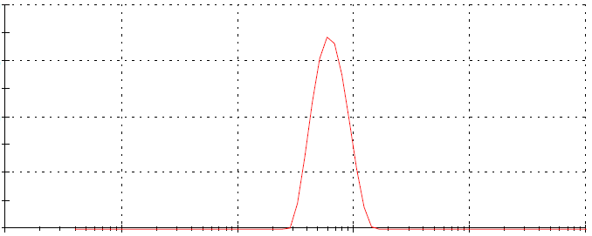
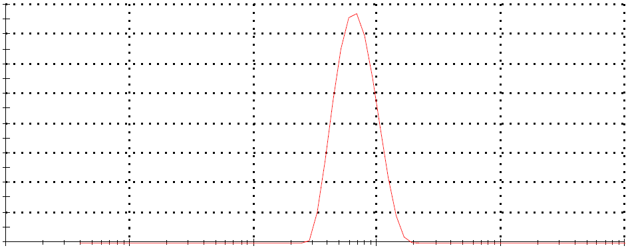
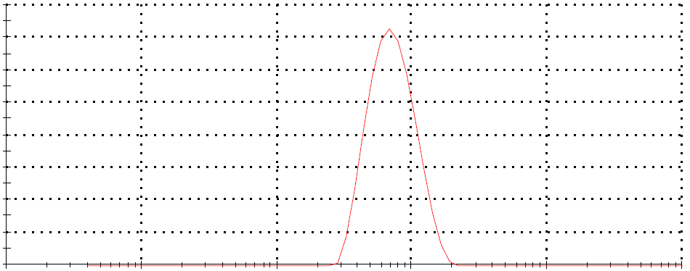
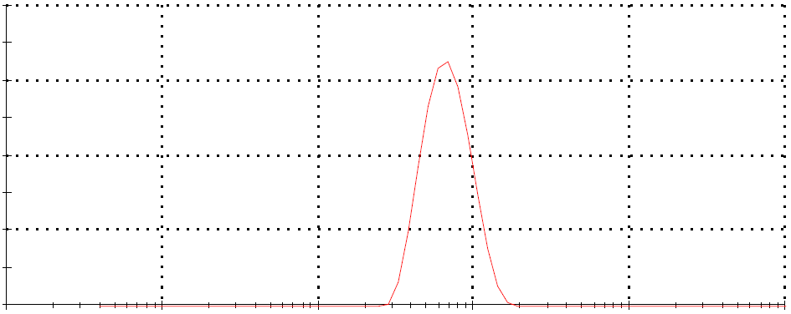
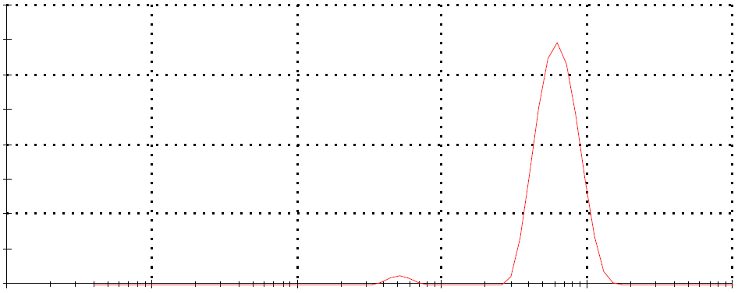
Figure S4B
20
16
15
0.5% PEG
12
1% PEG
10
8
5
4
0
0
16
1.5% PEG
20
2% PEG
Intensity (Percent)
15
12
8
10
4
5
0
0
20
3% PEG
20
4% PEG
15
15
10
10
5
5
0
0
0.1
1
10
100
1000
10000
0.1
1
10
100
1000
10000
Size (nm)
Figure S4. Post-insertion of PEG plateau as measured by DLS. (B) Graphs showing the size distribution by intensity as measured by DLS of LNPs containing Cy5-siRNA after incubation with DSPE-PEG₍₂₀₀₀₎-triazole-Cy3 at 45°C after 30 min. The percentage of post-inserted conjugated PEG is indicated at the top of each graph.

Slide 6
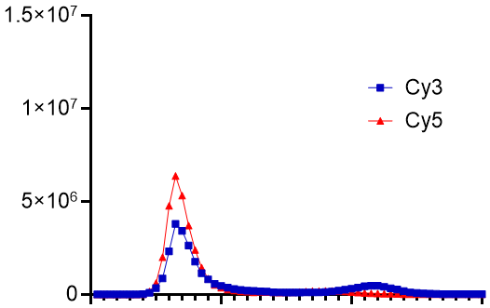
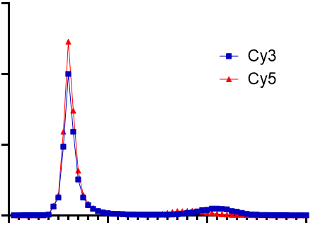
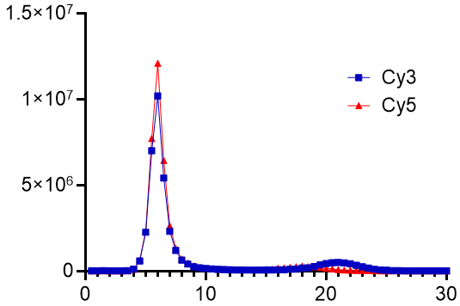
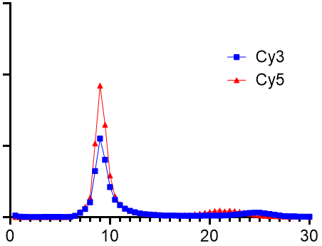
Figure S5
0 min
30 min
MFI
60 min
120 min
Elution volume (ml)
Figure S5. Repetition of post-insertion reaction kinetics. Graphs showing FPLC elution profiles of LNPs containing Cy5-siRNA after incubation with DSPE-PEG₍₂₀₀₀₎-triazole-Cy3 at 45°C after 0 to 2 hours. Reaction times are indicated at the top of each graph.

Slide 7
Table S1 –qPCR primer sequences.
Gene |  | Sequence (5' -> 3')
GAPDH | Forward | GAAGGTGAAGGTCGGAGTC
 | Reverse | GAAGATGGTGATGGGATTTC
RUNX1/ETO | Forward | AATCACAGTGGATGGGCCC
 | Reverse | TGCGTCTTCACATCCACAGG
TBP | Forward | CCTAAAGACCATTGCACTTCGT
 | Reverse | GTTCGTGGCTCTCTTATCCTCA

Slide 8
Table S2 - DLS measurement of DNA barcoded LNPs. The letters correspond with the CryoEM figure shown in Figure S1.
Sample | Z-average (nm) | PDI
A | 121 | 0.158
B | 194 | 0.150
C | 90 | 0.214

