Slide 1

The structure of denisovite, a fibrous nanocrystalline polytypic disordered `very complex' silicate, studied by a synergistic multi-disciplinary approach employing methods of electron crystallography and X-ray powder diffraction
I. V. Rozhdestvenskaya, E. Mugnaioli, M. Schowalter, M. U. Schmidt, M. Czank, W. Depmeier and A. Rosenauer
Volume 4 | Part 3 | May 2017 | Pages 223–242 | 10.1107/S2052252517002585
Notes:
Denisovite is a rare mineral occurring as fibres typically 200–500 nm in diameter, always characterized by pervasive disorder. Combining X-ray powder diffraction, high-angle annular dark-field scanning transmission electron microscopy imaging and electron diffraction tomography, it was possible to determine the denisovite structure and describe its disorder and polytypism by order–disorder theory. The denisovite structure ranks among the top 1% of the most complex mineral structures known to date.

Slide 2
The structure of denisovite, a fibrous nanocrystalline polytypic disordered `very complex' silicate, studied by a synergistic multi-disciplinary approach employing methods of electron crystallography and X-ray powder diffraction
Denisovite is a rare mineral occurring as fibres typically 200–500 nm in diameter, always characterized by pervasive disorder. Combining X-ray powder diffraction, high-angle annular dark-field scanning transmission electron microscopy imaging and electron diffraction tomography, it was possible to determine the denisovite structure and describe its disorder and polytypism by order–disorder theory. The denisovite structure ranks among the top 1% of the most complex mineral structures known to date.
Keywords: denisovite; minerals; fibrous materials; nanocrystalline materials; electron crystallography; electron diffraction tomography; X-ray powder diffraction; modularity; disorder; polytypism; OD approach; complexity; framework-structured solids; inorganic materials; nanostructure; nanoscience
Rozhdestvenskaya et al.
Volume 4 | Part 3 | May 2017 | Pages 223–242 | 10.1107/S2052252517002585
Notes:
Denisovite is a rare mineral occurring as aggregates of fibres typically 200–500 nm diameter. It was confirmed as a new mineral in 1984, but important facts about its chemical formula, lattice parameters, symmetry and structure have remained incompletely known since then. Recently obtained results from studies using microprobe analysis, X-ray powder diffraction (XRPD), electron crystallography, modelling and Rietveld refinement will be reported. The electron crystallography methods include transmission electron microscopy (TEM), selected-area electron diffraction (SAED), high-angle annular dark-field imaging (HAADF), high-resolution transmission electron microscopy (HRTEM), precession electron diffraction (PED) and electron diffraction tomography (EDT). A structural model of denisovite was developed from HAADF images and later completed on the basis of quasi-kinematic EDT data by ab initio structure solution using direct methods and least-squares refinement. The model was confirmed by Rietveld refinement. The lattice parameters are a = 31.024 (1), b = 19.554 (1) and c = 7.1441 (5) Å, β = 95.99 (3)°, V = 4310.1 (5) Å3 and space group P12/a1. The structure consists of three topologically distinct dreier silicate chains, viz. two xonotlite-like dreier double chains, [Si6O17]10−, and a tubular loop-branched dreier triple chain, [Si12O30]12−. The silicate chains occur between three walls of edge-sharing (Ca,Na) octahedra. The chains of silicate tetrahedra and the octahedra walls extend parallel to the z axis and form a layer parallel to (100). Water molecules and K+ cations are located at the centre of the tubular silicate chain. The latter also occupy positions close to the centres of eight-membered rings in the silicate chains. The silicate chains are geometrically constrained by neighbouring octahedra walls and present an ambiguity with respect to their z position along these walls, with displacements between neighbouring layers being either Δz = c/4 or −c/4. Such behaviour is typical for polytypic sequences and leads to disorder along [100]. In fact, the diffraction pattern does not show any sharp reflections with l odd, but continuous diffuse streaks parallel to a* instead. Only reflections with l even are sharp. The diffuse scattering is caused by (100) nano­lamellae separated by stacking faults and twin boundaries. The structure can be described according to the order–disorder (OD) theory as a stacking of layers parallel to (100).

Slide 3
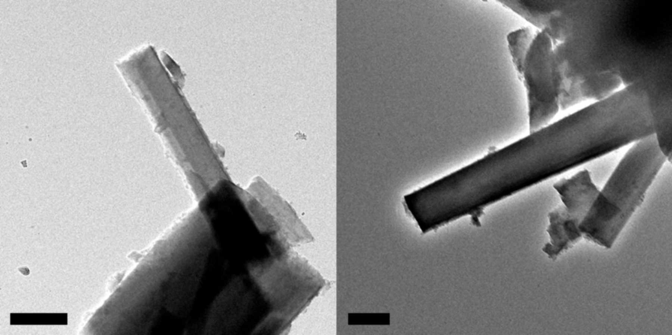
Figure 1. TEM images of crushed denisovite crystal fibres used for EDT data acquisition (namely crystal 1 and crystal 3). The scale bar is 200 nm.
Rozhdestvenskaya et al.
Volume 4 | Part 3 | May 2017 | Pages 223–242 | 10.1107/S2052252517002585
Notes:
TEM images of crushed denisovite crystal fibres used for EDT data acquisition (namely crystal 1 and crystal 3). The scale bar is 200 nm. [Rozhdestvenskaya, I. V., Mugnaioli, E., Schowalter, M., Schmidt, M. U., Czank, M., Depmeier, W. and Rosenauer, A. (2017). IUCrJ, 4, 223-242. 10.1107/S2052252517002585]

Slide 4
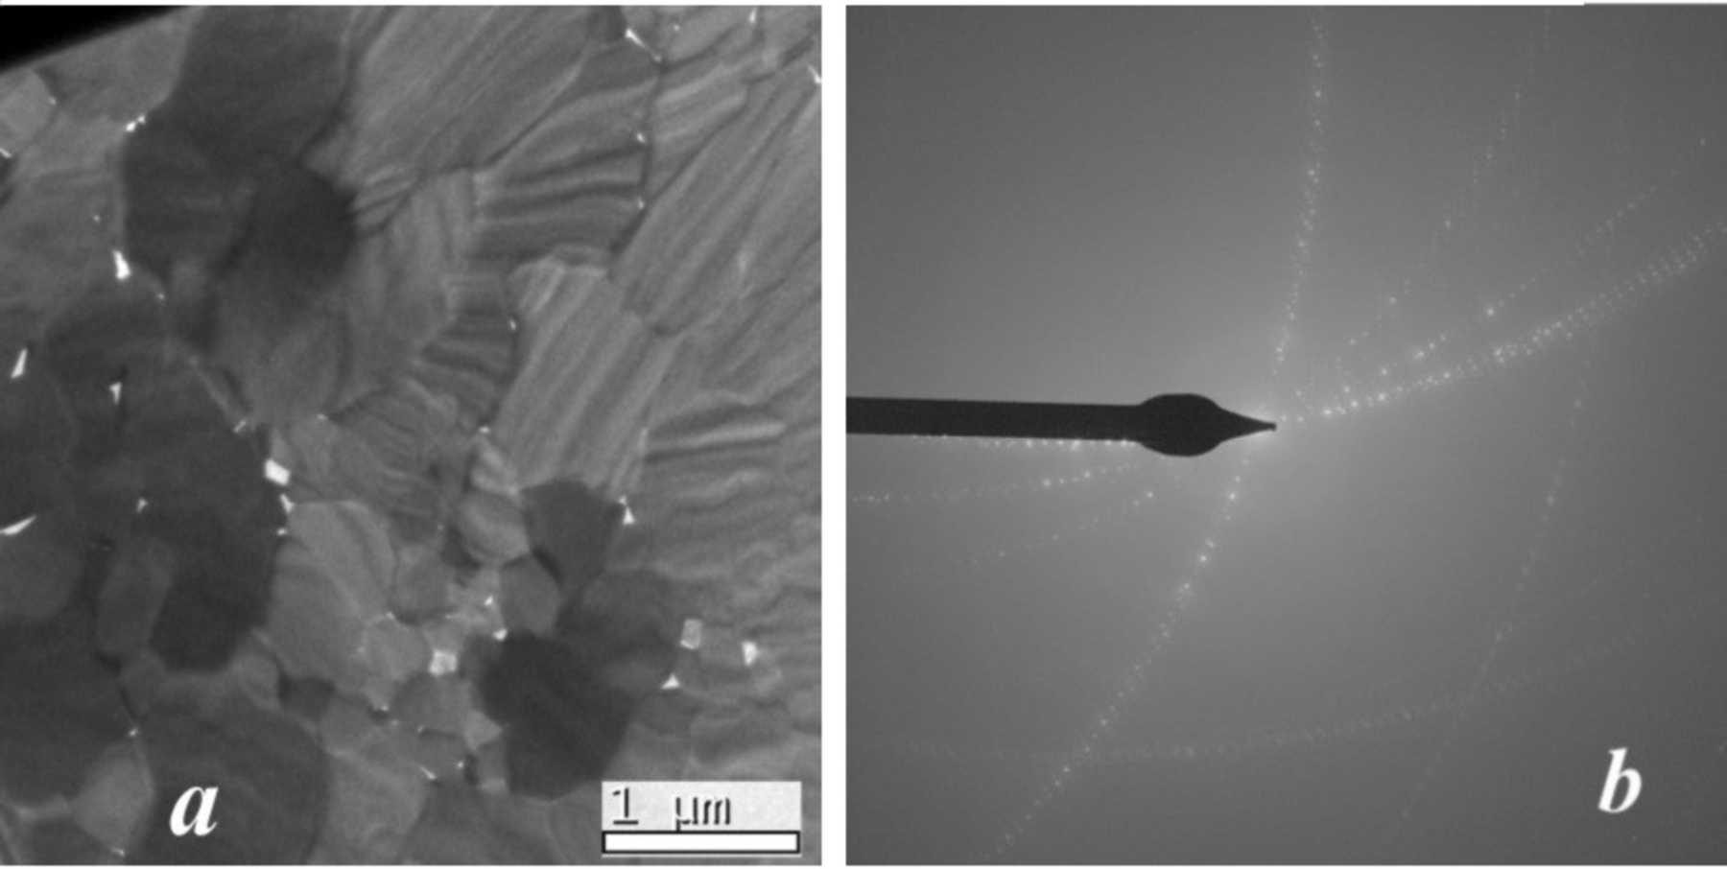
Figure 2. (a) Overview of an FIB prepared cross section (perpendicular to the c axis) of a fibrous denisovite sample. (b) SAED of an area containing four fibres. The sample is slightly ...
Rozhdestvenskaya et al.
Volume 4 | Part 3 | May 2017 | Pages 223–242 | 10.1107/S2052252517002585
Notes:
(a) Overview of an FIB prepared cross section (perpendicular to the c axis) of a fibrous denisovite sample. (b) SAED of an area containing four fibres. The sample is slightly tilted out of the zone-axis orientation for better visualization of the different orientations of the fibres. [Rozhdestvenskaya, I. V., Mugnaioli, E., Schowalter, M., Schmidt, M. U., Czank, M., Depmeier, W. and Rosenauer, A. (2017). IUCrJ, 4, 223-242. 10.1107/S2052252517002585]

Slide 5
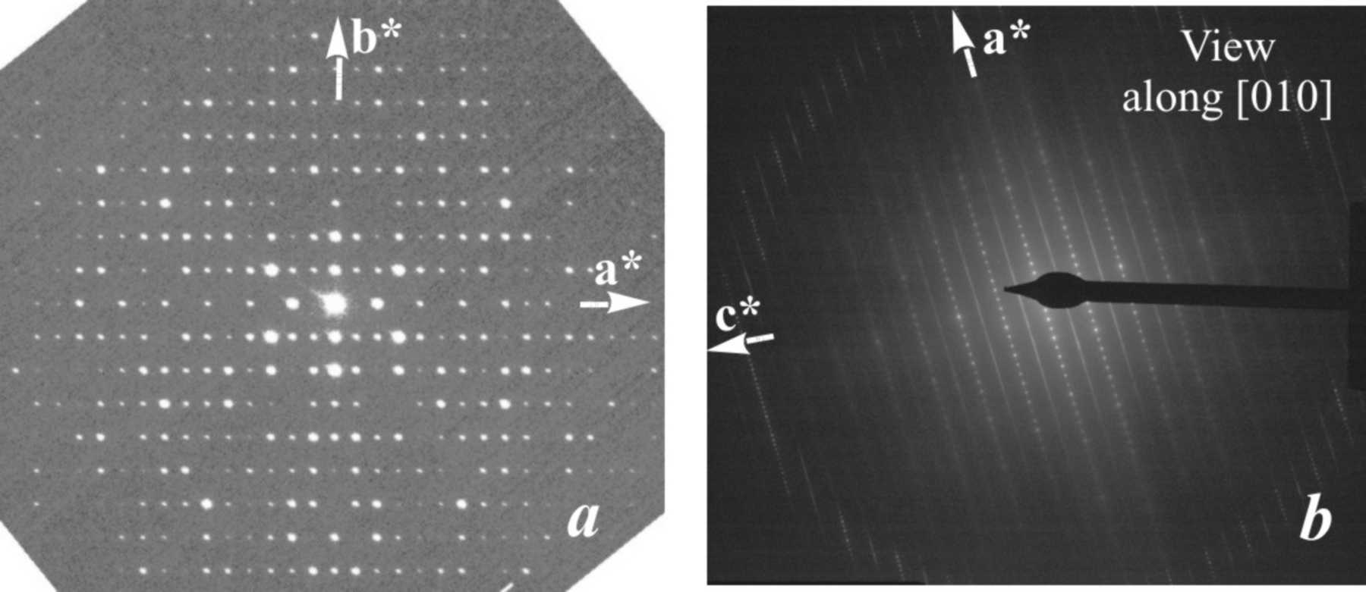
Figure 3. (a) SAED pattern along the c axis, showing that the a* and b* axes are mutually orthogonal. On the pattern, mirror symmetry exists along both axes and the reflection ...
Rozhdestvenskaya et al.
Volume 4 | Part 3 | May 2017 | Pages 223–242 | 10.1107/S2052252517002585
Notes:
(a) SAED pattern along the c axis, showing that the a* and b* axes are mutually orthogonal. On the pattern, mirror symmetry exists along both axes and the reflection conditions h00: h = 2n are present. Weak violations of this rule are thought to be the result of residual dynamic effects. (b) SAED pattern along the b axis. In the pattern of the zero-order Laue zone (h0l reflections, inner circle) the reflections h = 2n + 1 are extinct in all reciprocal rows with l = 2n, while in the pattern of the first-order Laue zone (h1l reflections, outer ring) no systematic absences are observed. [Rozhdestvenskaya, I. V., Mugnaioli, E., Schowalter, M., Schmidt, M. U., Czank, M., Depmeier, W. and Rosenauer, A. (2017). IUCrJ, 4, 223-242. 10.1107/S2052252517002585]

Slide 6
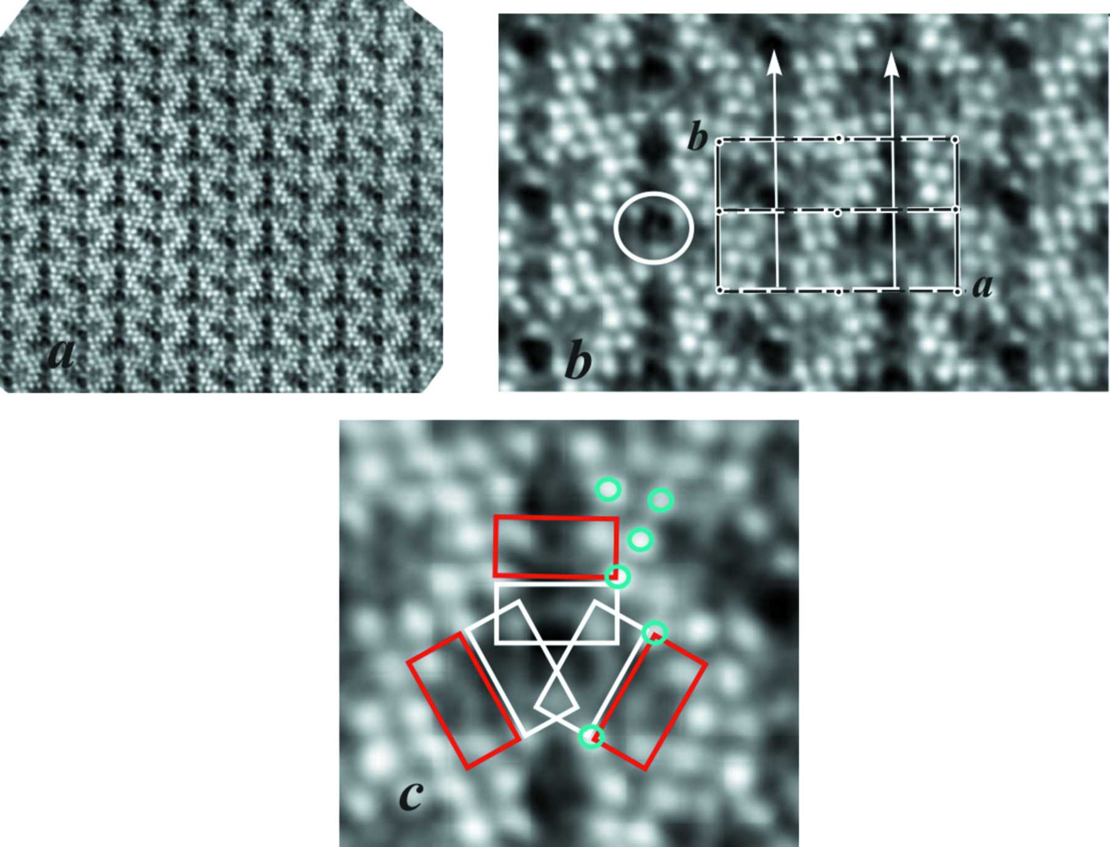
Figure 4. (a) Filtered [001] HAADF image of denisovite. (b) Enlarged part with the unit cell and symmetry elements; one of the circular contrasts is marked by a white circle. (c) Three ...
Rozhdestvenskaya et al.
Volume 4 | Part 3 | May 2017 | Pages 223–242 | 10.1107/S2052252517002585
Notes:
(a) Filtered [001] HAADF image of denisovite. (b) Enlarged part with the unit cell and symmetry elements; one of the circular contrasts is marked by a white circle. (c) Three weak arch-like fragments (red rectangles) are situated close to the three weak arch-like areas of the circular contrast (white rectangles). Turquoise circles indicate independent Ca positions. [Rozhdestvenskaya, I. V., Mugnaioli, E., Schowalter, M., Schmidt, M. U., Czank, M., Depmeier, W. and Rosenauer, A. (2017). IUCrJ, 4, 223-242. 10.1107/S2052252517002585]

Slide 7
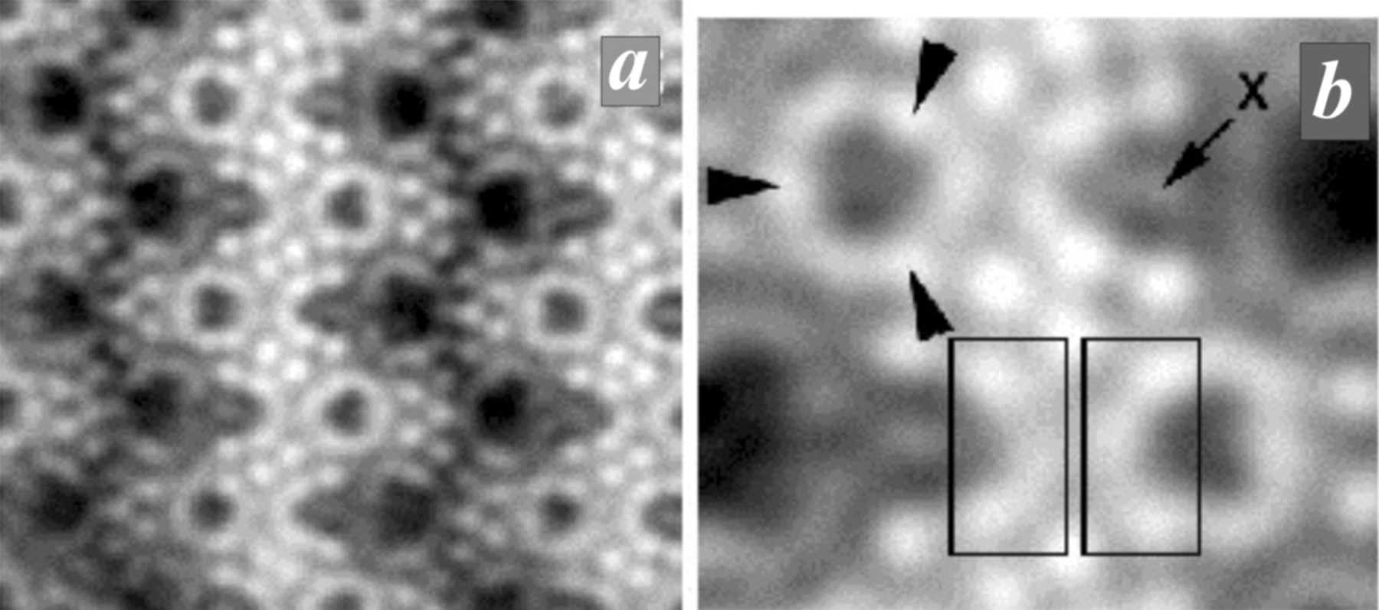
Figure 5. [001] HAADF-STEM images of charoite: (a) An overview. (b) Enlarged part of panel (a). The circular contrast has three stronger spots marked by arrowheads. The arch-like contrast ...
Rozhdestvenskaya et al.
Volume 4 | Part 3 | May 2017 | Pages 223–242 | 10.1107/S2052252517002585
Notes:
[001] HAADF-STEM images of charoite: (a) An overview. (b) Enlarged part of panel (a). The circular contrast has three stronger spots marked by arrowheads. The arch-like contrast has intense spots at both ends (left rectangle) and resembles part of the circular contrast (right rectangle). It is thought that the arch-like unit consists of two pectolite chains forming xonotlite dreier double chains with formula [Si6O17]10−. [Rozhdestvenskaya, I. V., Mugnaioli, E., Schowalter, M., Schmidt, M. U., Czank, M., Depmeier, W. and Rosenauer, A. (2017). IUCrJ, 4, 223-242. 10.1107/S2052252517002585]

Slide 8
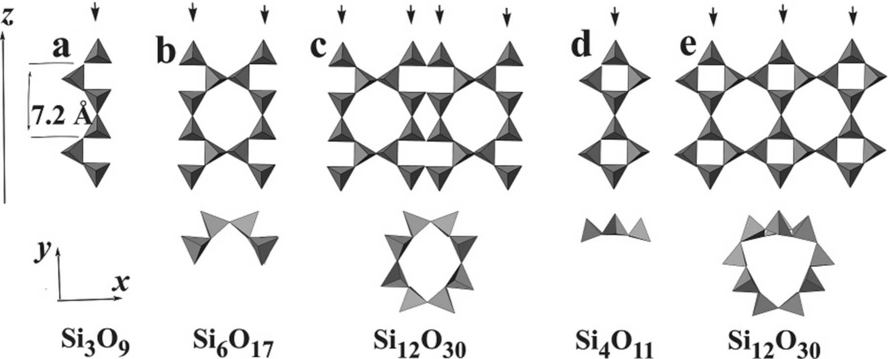
Figure 6. Dreier silicate chains, (top) unfolded and (bottom) viewed along the chain direction. (a) Dreier single tetrahedra chain (pectolite-like). (b) Dreier double chain (xonotlite-like) ...
Rozhdestvenskaya et al.
Volume 4 | Part 3 | May 2017 | Pages 223–242 | 10.1107/S2052252517002585
Notes:
Dreier silicate chains, (top) unfolded and (bottom) viewed along the chain direction. (a) Dreier single tetrahedra chain (pectolite-like). (b) Dreier double chain (xonotlite-like). (c) Unfolded drawing of the tubular dreier triple chain in frankamenite and miserite. (d) Loop-branched dreier single chain. (e) Unfolded tubular loop-branched dreier triple chain in charoite and denisovite. Rows of superimposed tetrahedra along the tubular axis are indicated by arrowheads. In panels (b), (c) and (e), eight-membered rings of tetrahedra exist, `8MR'. [Rozhdestvenskaya, I. V., Mugnaioli, E., Schowalter, M., Schmidt, M. U., Czank, M., Depmeier, W. and Rosenauer, A. (2017). IUCrJ, 4, 223-242. 10.1107/S2052252517002585]

Slide 9
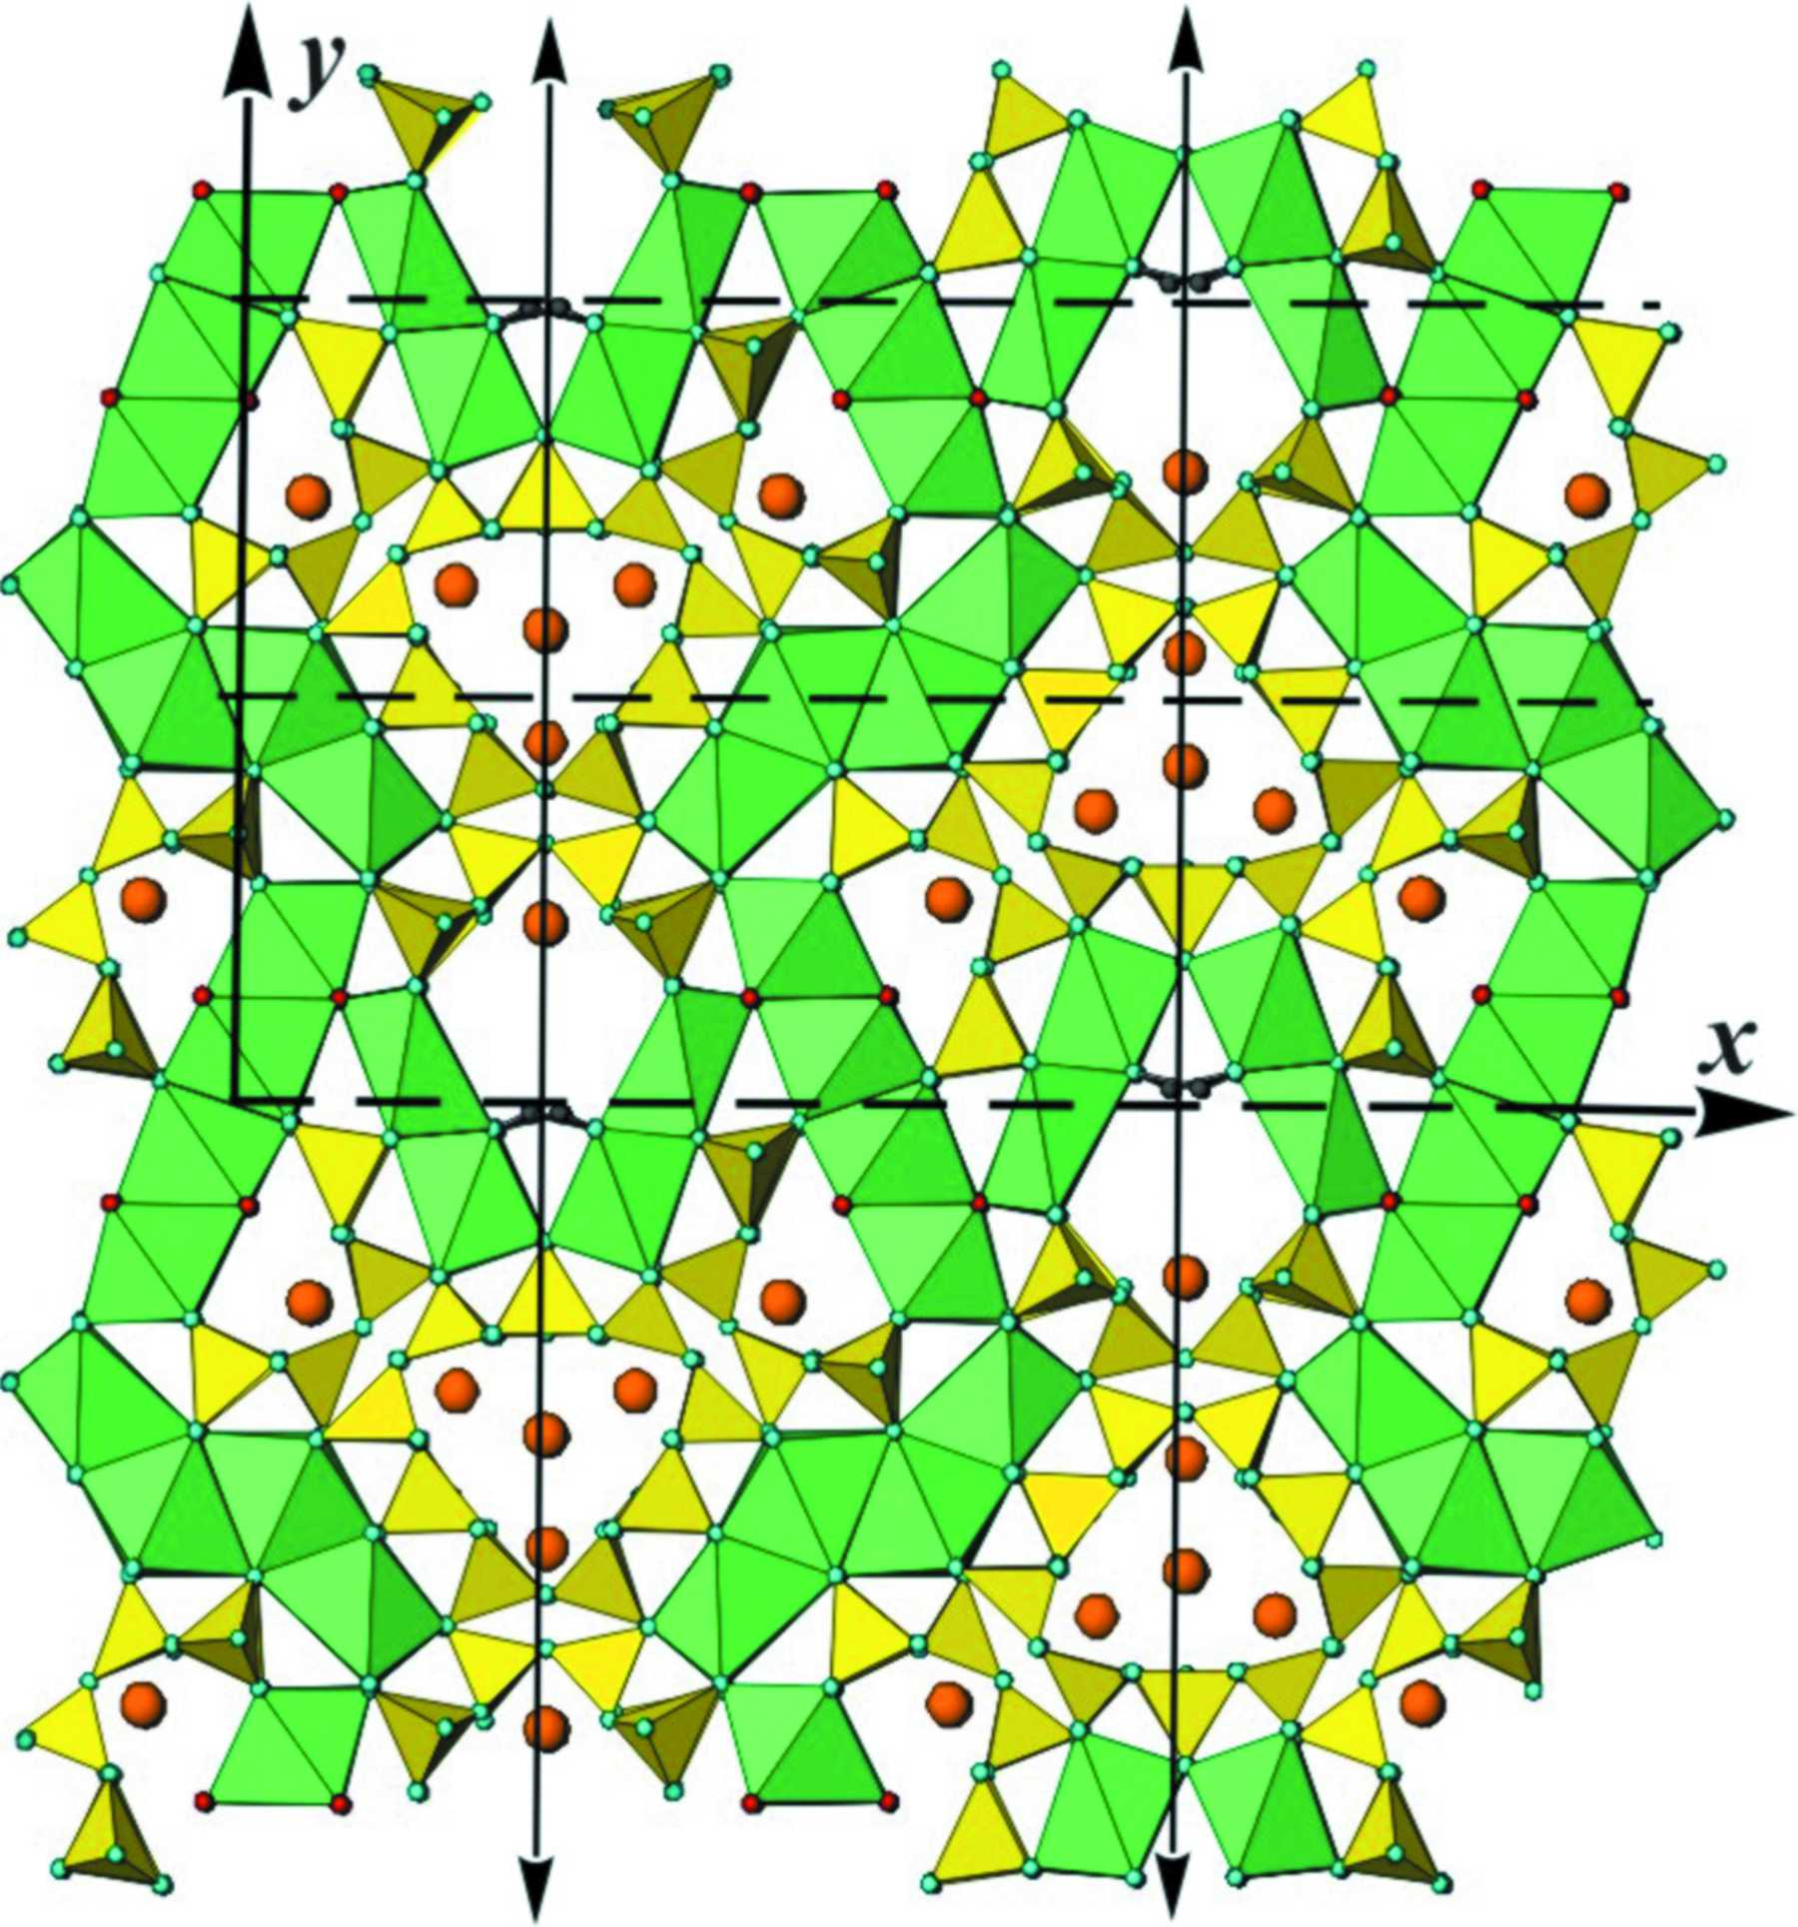
Figure 7. The structural model of denisovite based on HAADF image interpretation. The unit cell and symmetry elements are shown. Silicate chains are shown in yellow, (Ca,Na) octahedra in green and K⁺ ...
Rozhdestvenskaya et al.
Volume 4 | Part 3 | May 2017 | Pages 223–242 | 10.1107/S2052252517002585
Notes:
The structural model of denisovite based on HAADF image interpretation. The unit cell and symmetry elements are shown. Silicate chains are shown in yellow, (Ca,Na) octahedra in green and K+ ions as large brown circles, and turquoise, purple and black small circles represent oxygen, F/OH and H positions, respectively. [Rozhdestvenskaya, I. V., Mugnaioli, E., Schowalter, M., Schmidt, M. U., Czank, M., Depmeier, W. and Rosenauer, A. (2017). IUCrJ, 4, 223-242. 10.1107/S2052252517002585]

Slide 10
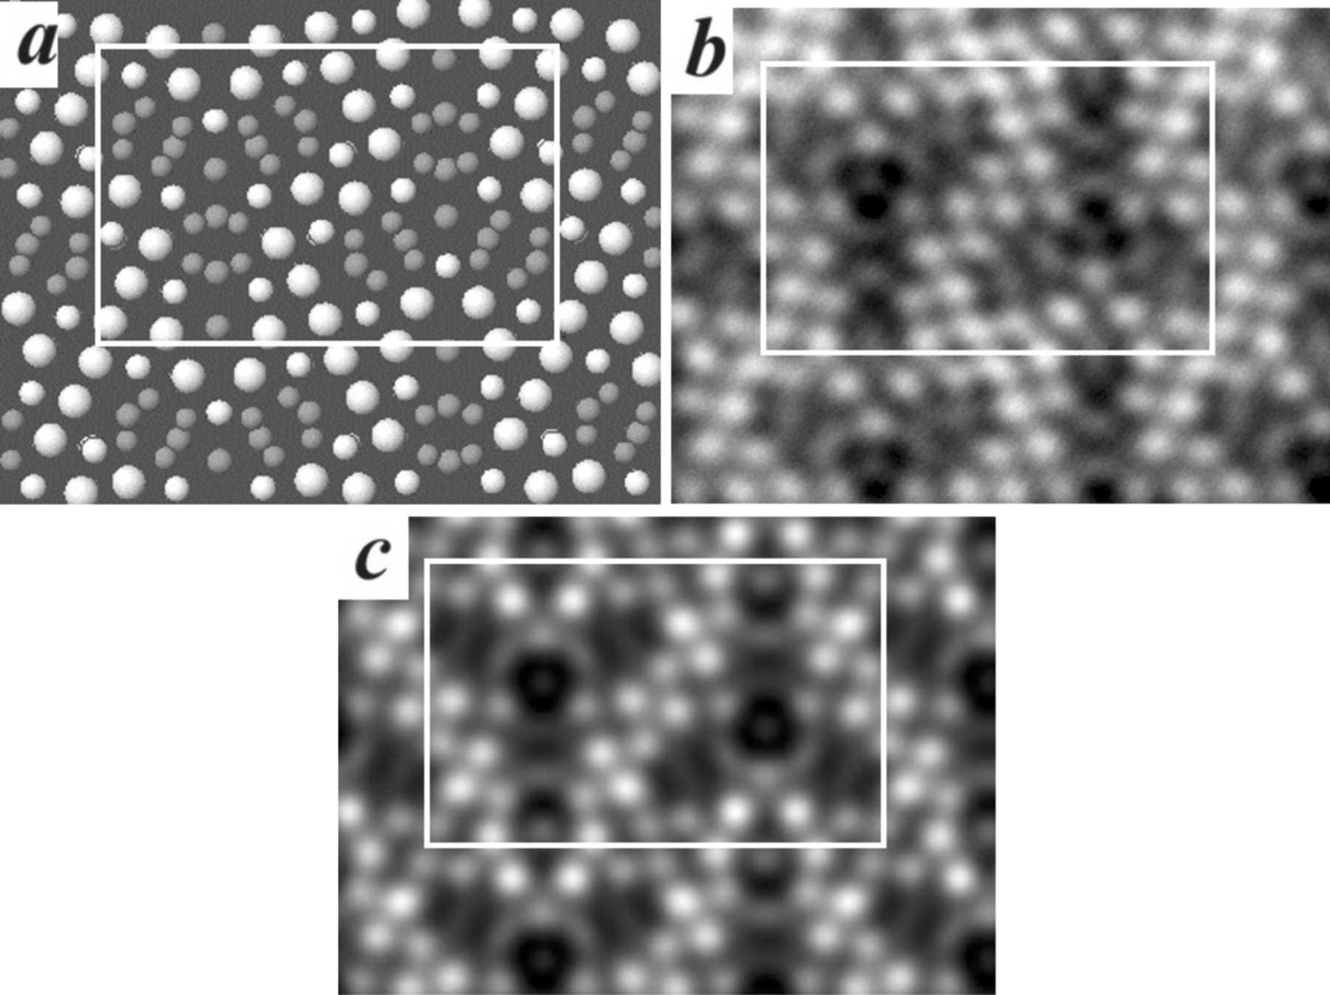
Figure 8. (a) The structure of denisovite projected along the z axis; only Ca, K and Si atoms are shown. Large white balls represent Ca atoms, small white balls represent Si atoms in vertical ...
Rozhdestvenskaya et al.
Volume 4 | Part 3 | May 2017 | Pages 223–242 | 10.1107/S2052252517002585
Notes:
(a) The structure of denisovite projected along the z axis; only Ca, K and Si atoms are shown. Large white balls represent Ca atoms, small white balls represent Si atoms in vertical Si2O7 groups, and small grey balls represent Si atoms in horizontal Si2O7 groups and K atoms. (b) Experimental HAADF image of denisovite. (c) Simulated HAADF image calculated from the ab initio structure. [Rozhdestvenskaya, I. V., Mugnaioli, E., Schowalter, M., Schmidt, M. U., Czank, M., Depmeier, W. and Rosenauer, A. (2017). IUCrJ, 4, 223-242. 10.1107/S2052252517002585]

Slide 11
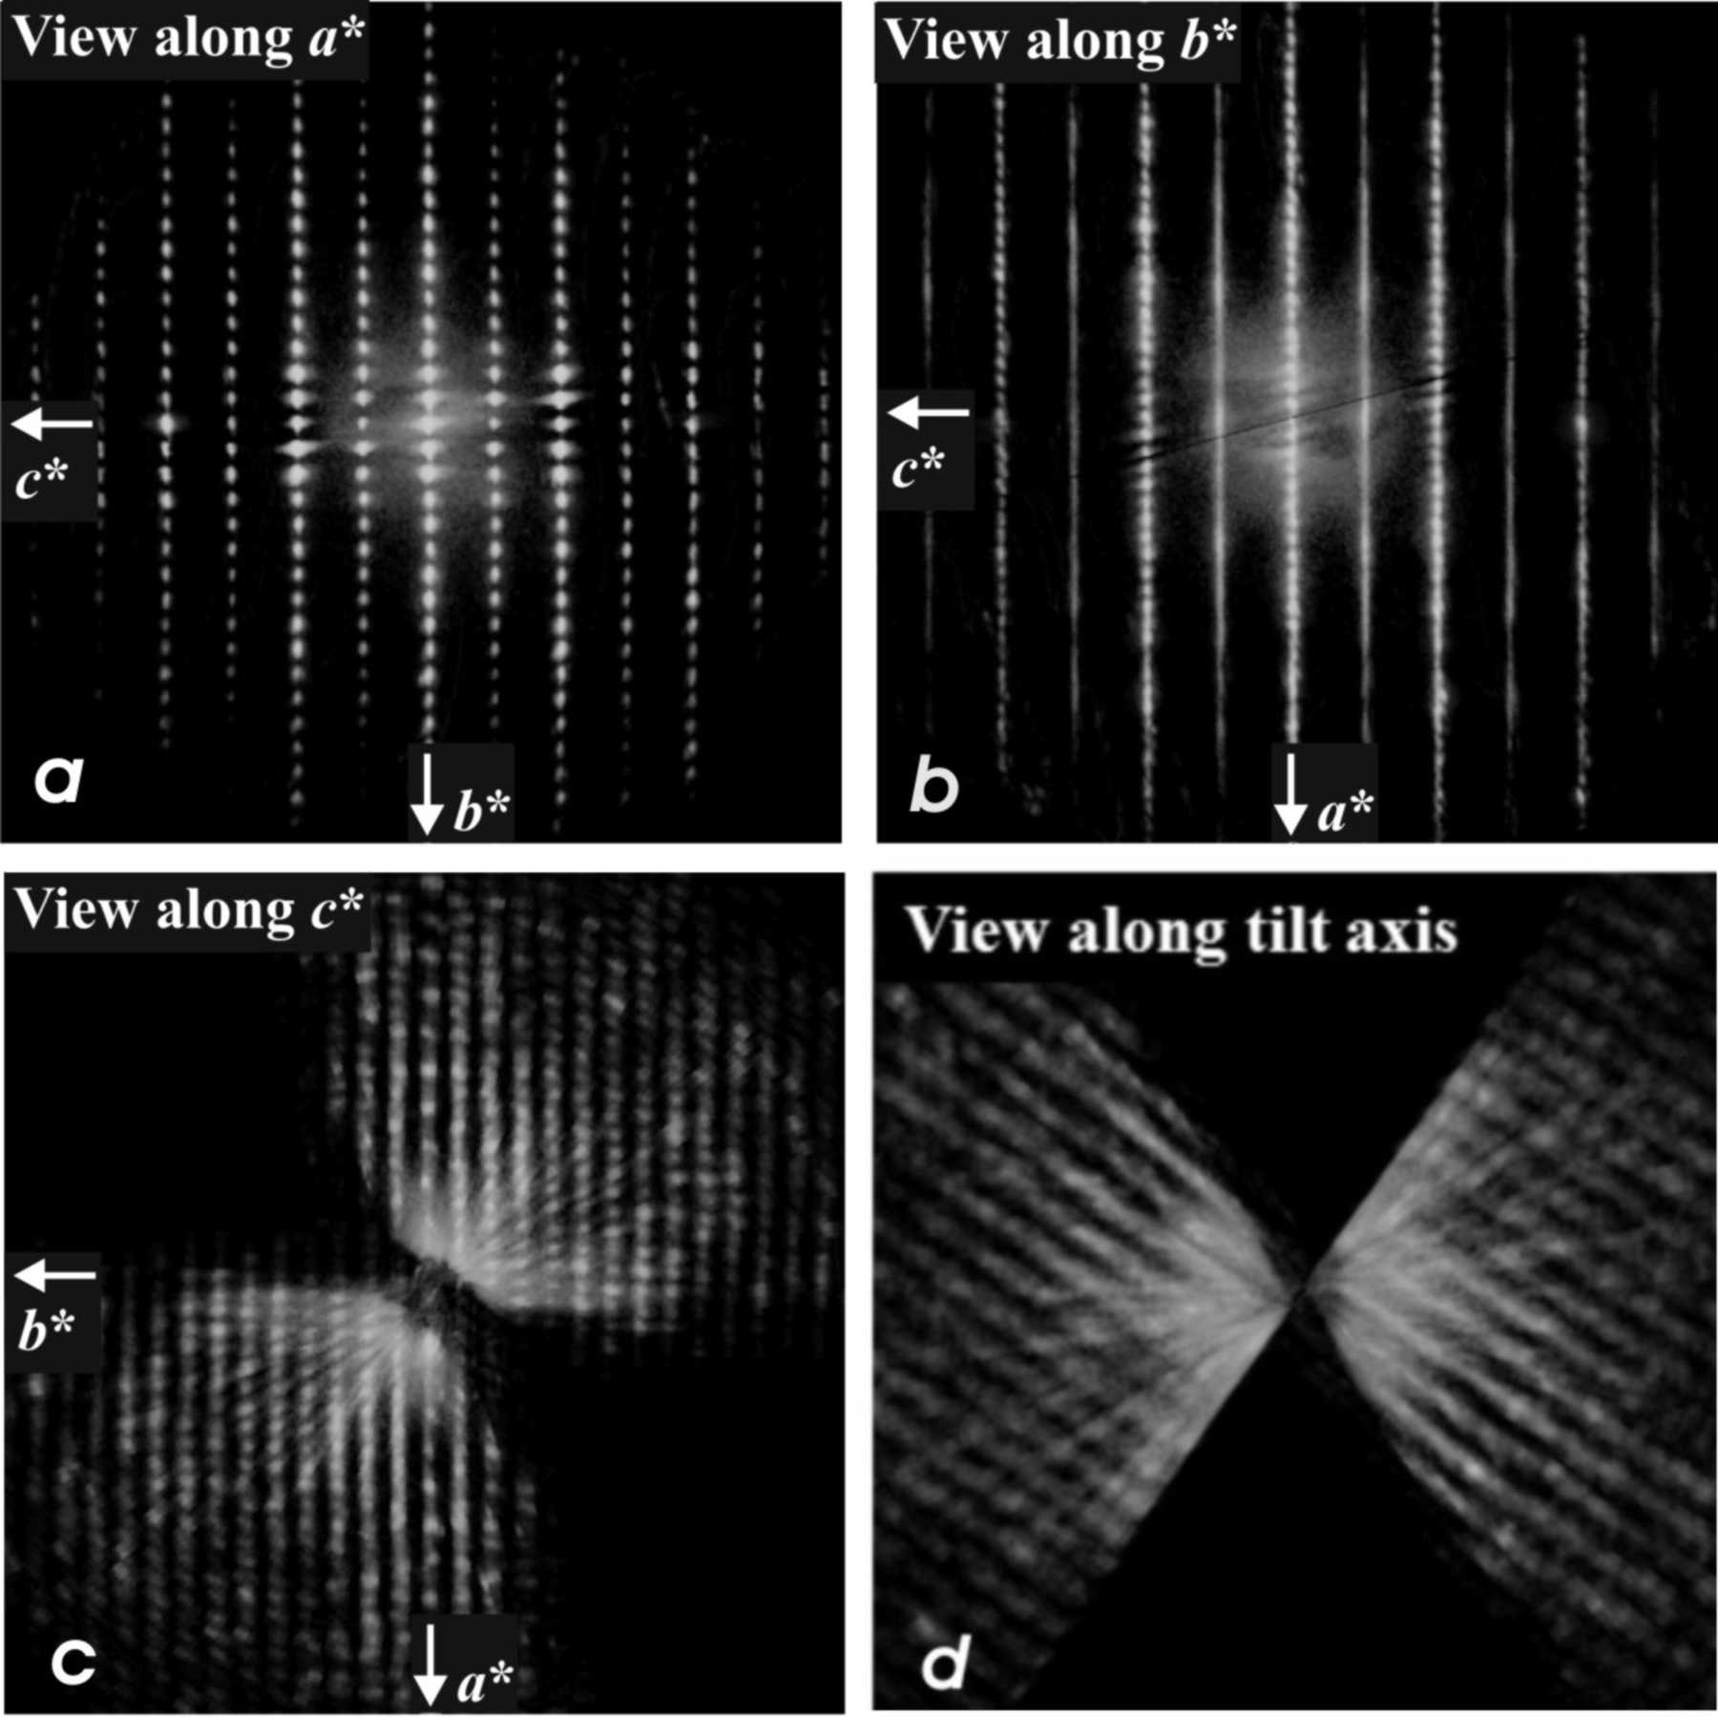
Figure 9. (a) EDT three-dimensional diffraction volume of denisovite viewed along a*. Reflections hkl: l = 2n + 1 are weaker but there is no evidence of diffuse scattering ...
Rozhdestvenskaya et al.
Volume 4 | Part 3 | May 2017 | Pages 223–242 | 10.1107/S2052252517002585
Notes:
(a) EDT three-dimensional diffraction volume of denisovite viewed along a*. Reflections hkl: l = 2n + 1 are weaker but there is no evidence of diffuse scattering. (b) EDT three-dimensional diffraction volume of denisovite viewed along b*. Reflections hkl: l = 2n + 1 are weaker and show strong diffuse scattering along a*. (c) EDT three-dimensional diffraction volume of denisovite viewed along c*. (d) EDT three-dimensional diffraction volume of denisovite viewed along the tilt axis of the acquisition. [Rozhdestvenskaya, I. V., Mugnaioli, E., Schowalter, M., Schmidt, M. U., Czank, M., Depmeier, W. and Rosenauer, A. (2017). IUCrJ, 4, 223-242. 10.1107/S2052252517002585]

Slide 12
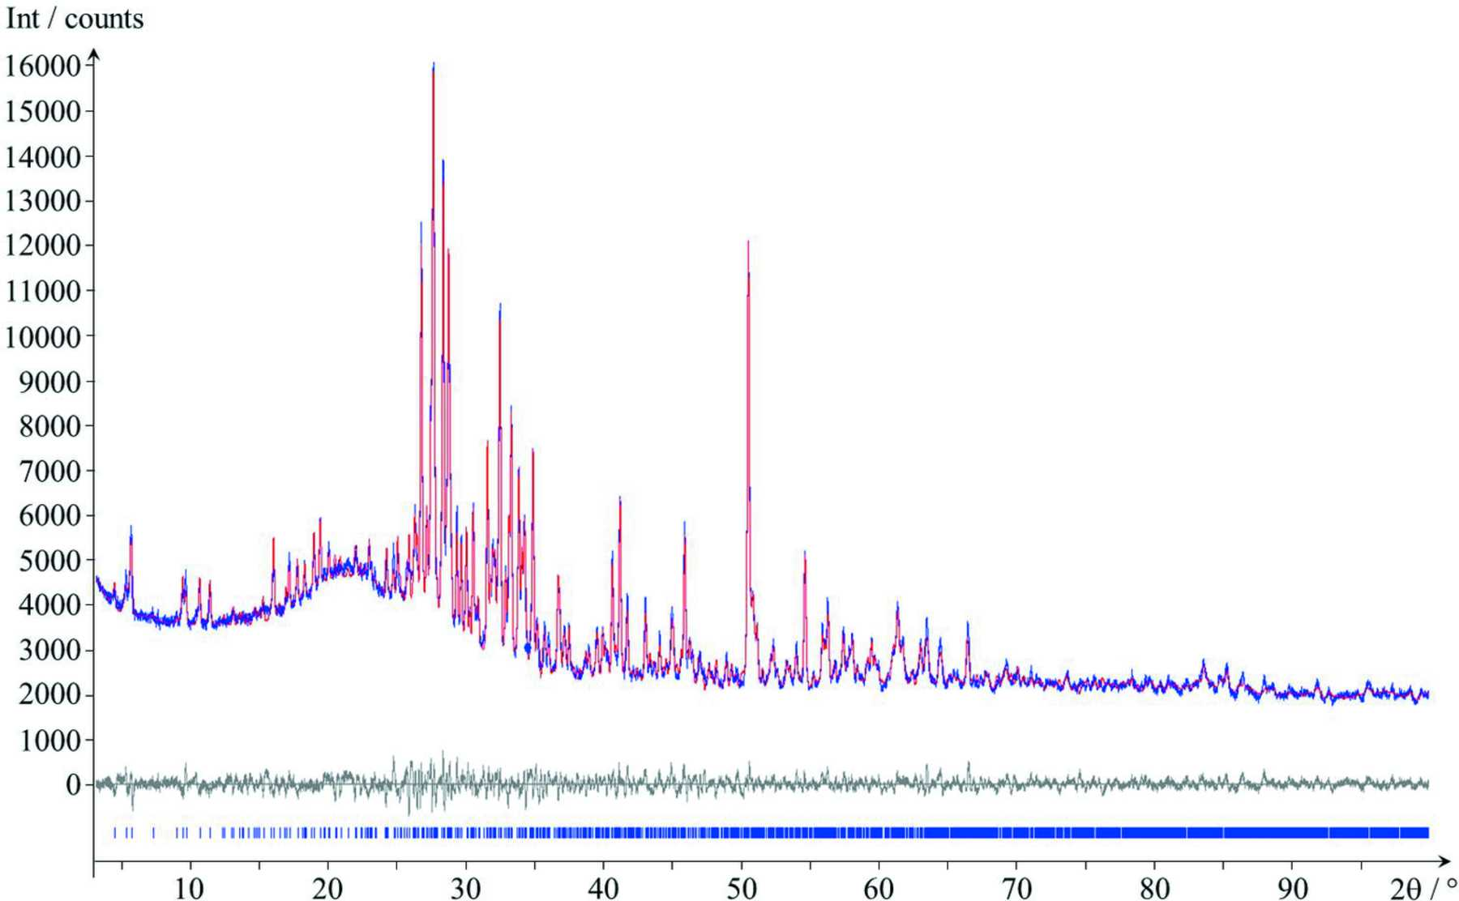
Figure 10. Rietveld plot. Experimental data are shown in blue, simulated data in red and the difference curve in grey. The blue vertical tick marks denote the reflection positions.
Rozhdestvenskaya et al.
Volume 4 | Part 3 | May 2017 | Pages 223–242 | 10.1107/S2052252517002585
Notes:
Rietveld plot. Experimental data are shown in blue, simulated data in red and the difference curve in grey. The blue vertical tick marks denote the reflection positions. [Rozhdestvenskaya, I. V., Mugnaioli, E., Schowalter, M., Schmidt, M. U., Czank, M., Depmeier, W. and Rosenauer, A. (2017). IUCrJ, 4, 223-242. 10.1107/S2052252517002585]

Slide 13
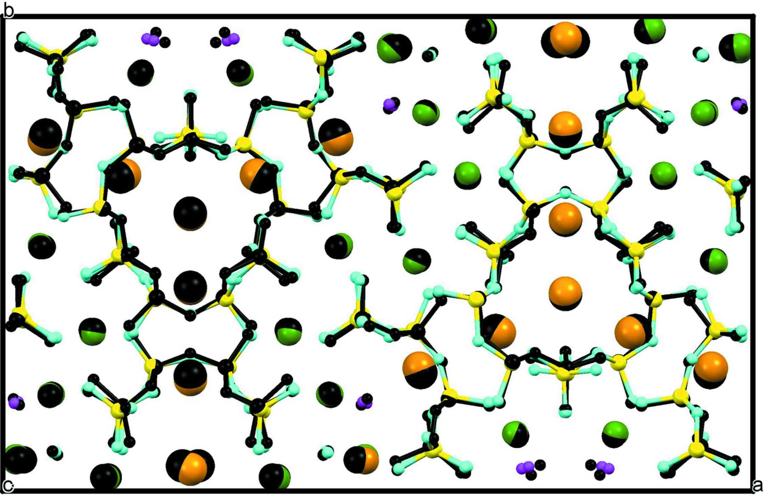
Figure 11. Superposition of the structures from EDT (coloured) and Rietveld refinement (black). Colour codes: Si yellow, O turquoise, Ca and Na green, K brown, and F purple.
Rozhdestvenskaya et al.
Volume 4 | Part 3 | May 2017 | Pages 223–242 | 10.1107/S2052252517002585
Notes:
Superposition of the structures from EDT (coloured) and Rietveld refinement (black). Colour codes: Si yellow, O turquoise, Ca and Na green, K brown, and F purple. [Rozhdestvenskaya, I. V., Mugnaioli, E., Schowalter, M., Schmidt, M. U., Czank, M., Depmeier, W. and Rosenauer, A. (2017). IUCrJ, 4, 223-242. 10.1107/S2052252517002585]

Slide 14
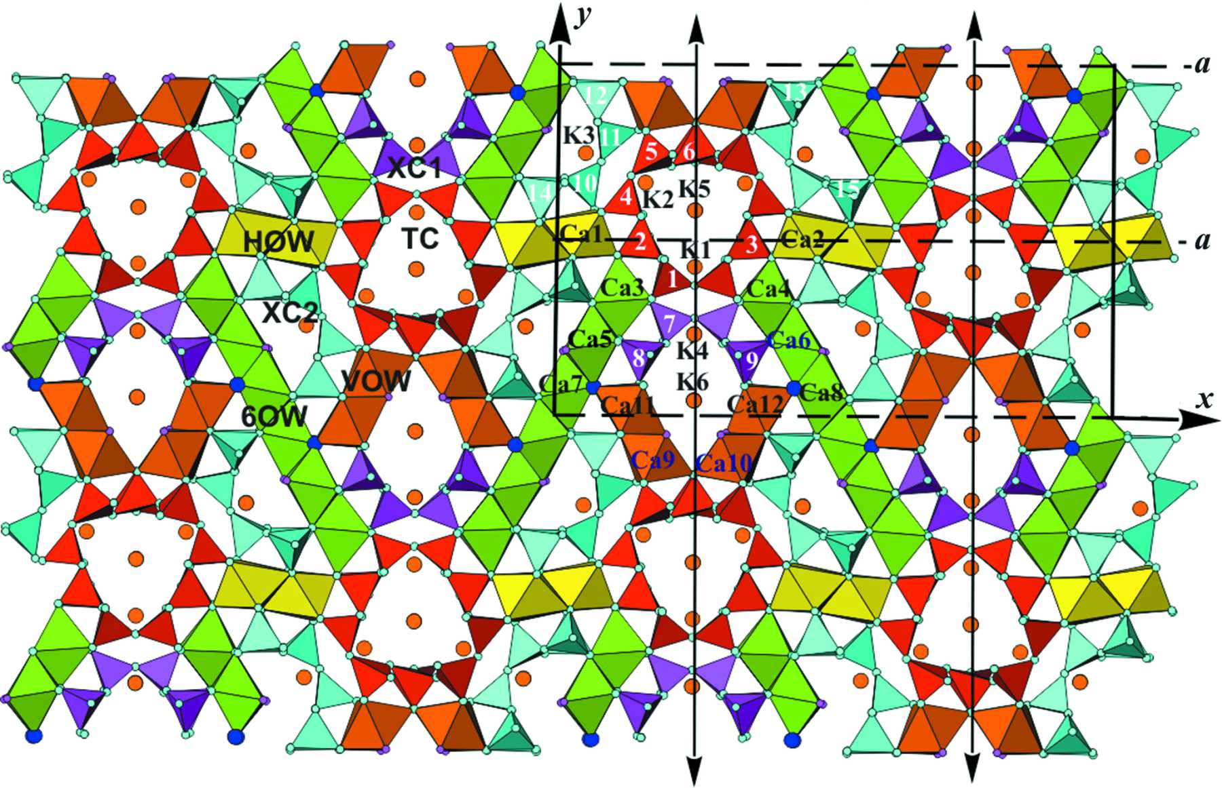
Figure 12. A polyhedral representation of the denisovite structure as obtained from the ab initio structure solution, shown down the z axis. The unit cell and symmetry elements are shown. ...
Rozhdestvenskaya et al.
Volume 4 | Part 3 | May 2017 | Pages 223–242 | 10.1107/S2052252517002585
Notes:
A polyhedral representation of the denisovite structure as obtained from the ab initio structure solution, shown down the z axis. The unit cell and symmetry elements are shown. Tubular loop-branched dreier triple chains [Si12O30]12− (TC) are shown in red, and xonotlite-like dreier double chains [Si6O17]10− (XC1) and (XC2) are shown in purple and turquoise, respectively; `horizontal' octahedra walls (HOW) are coloured yellow, walls from two (Ca9—Ca12) octahedra (VOW) brown and six-octahedra-wide walls (6OW) green. Small turquoise circles are O atoms, purple circles are F atoms, O43 and O44 are marked by blue circles and large brown circles indicate K atoms. Si atoms are numbered. [Rozhdestvenskaya, I. V., Mugnaioli, E., Schowalter, M., Schmidt, M. U., Czank, M., Depmeier, W. and Rosenauer, A. (2017). IUCrJ, 4, 223-242. 10.1107/S2052252517002585]

Slide 15
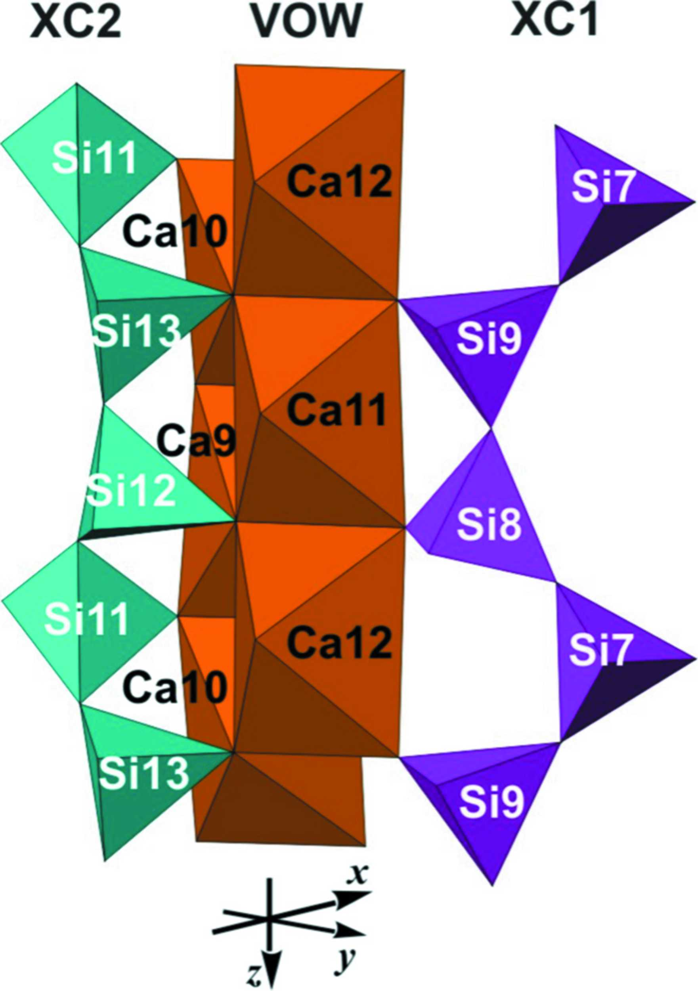
Figure 13. Denisovite, two strands of XC2 (turquoise) and XC1 (purple) on opposite sides of a VOW, showing that they are not displaced along z with respect to each other.
Rozhdestvenskaya et al.
Volume 4 | Part 3 | May 2017 | Pages 223–242 | 10.1107/S2052252517002585
Notes:
Denisovite, two strands of XC2 (turquoise) and XC1 (purple) on opposite sides of a VOW, showing that they are not displaced along z with respect to each other. [Rozhdestvenskaya, I. V., Mugnaioli, E., Schowalter, M., Schmidt, M. U., Czank, M., Depmeier, W. and Rosenauer, A. (2017). IUCrJ, 4, 223-242. 10.1107/S2052252517002585]

Slide 16
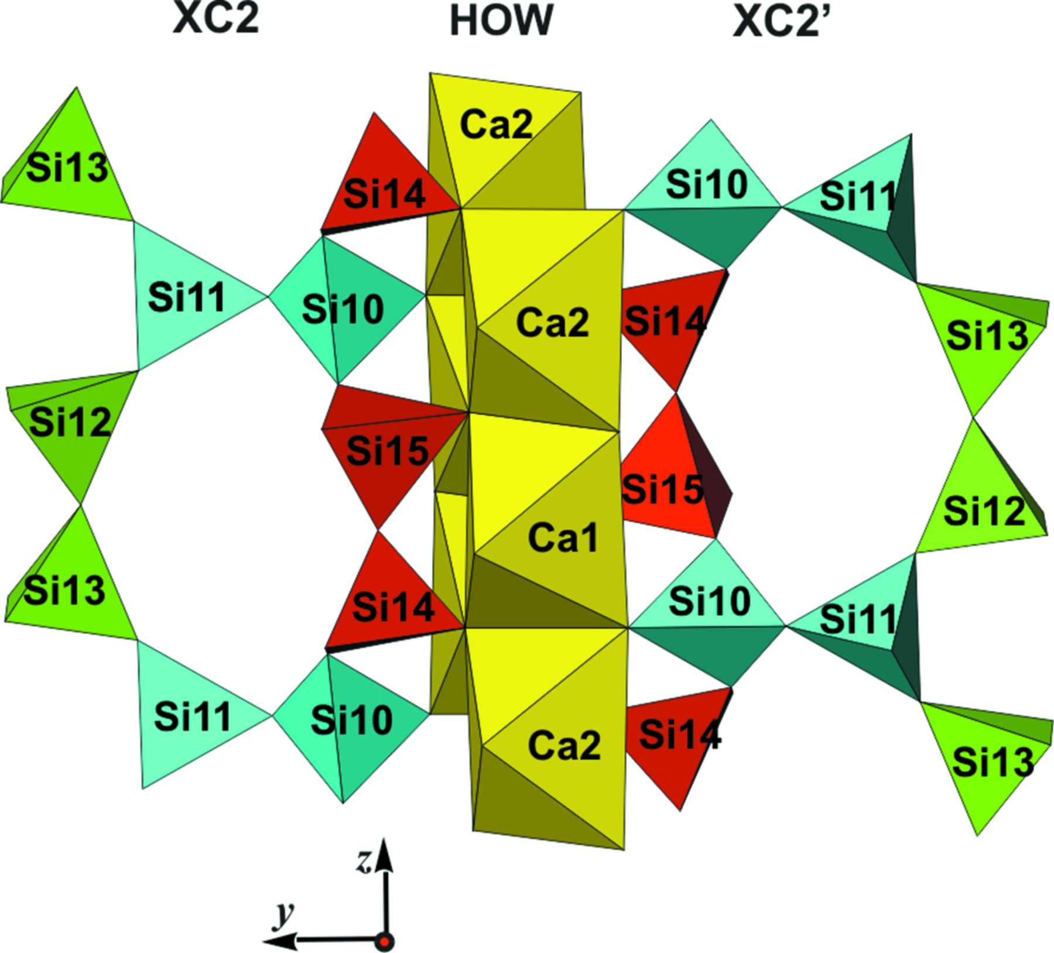
Figure 14. Denisovite, two XC2 on opposite sides of an HOW, showing their relative displacement by c/4.
Rozhdestvenskaya et al.
Volume 4 | Part 3 | May 2017 | Pages 223–242 | 10.1107/S2052252517002585
Notes:
Denisovite, two XC2 on opposite sides of an HOW, showing their relative displacement by c/4. [Rozhdestvenskaya, I. V., Mugnaioli, E., Schowalter, M., Schmidt, M. U., Czank, M., Depmeier, W. and Rosenauer, A. (2017). IUCrJ, 4, 223-242. 10.1107/S2052252517002585]

Slide 17
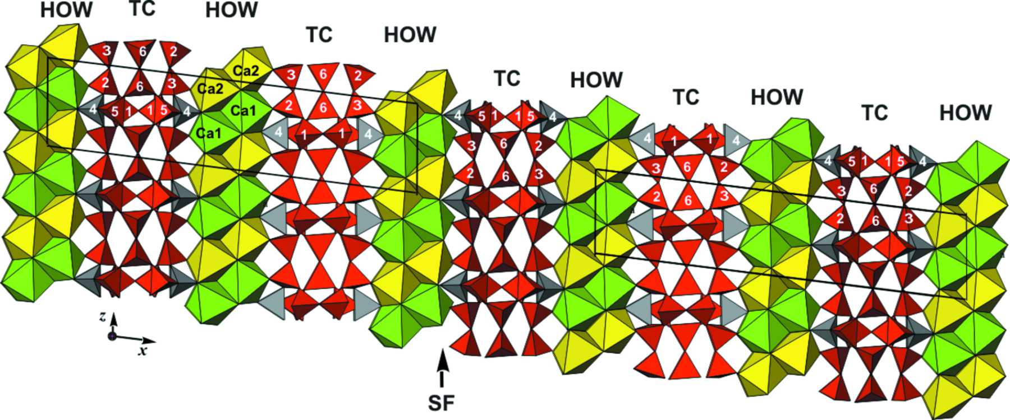
Figure 15. Denisovite, schematic view of a stacking fault.
Rozhdestvenskaya et al.
Volume 4 | Part 3 | May 2017 | Pages 223–242 | 10.1107/S2052252517002585
Notes:
Denisovite, schematic view of a stacking fault. [Rozhdestvenskaya, I. V., Mugnaioli, E., Schowalter, M., Schmidt, M. U., Czank, M., Depmeier, W. and Rosenauer, A. (2017). IUCrJ, 4, 223-242. 10.1107/S2052252517002585]

Slide 18
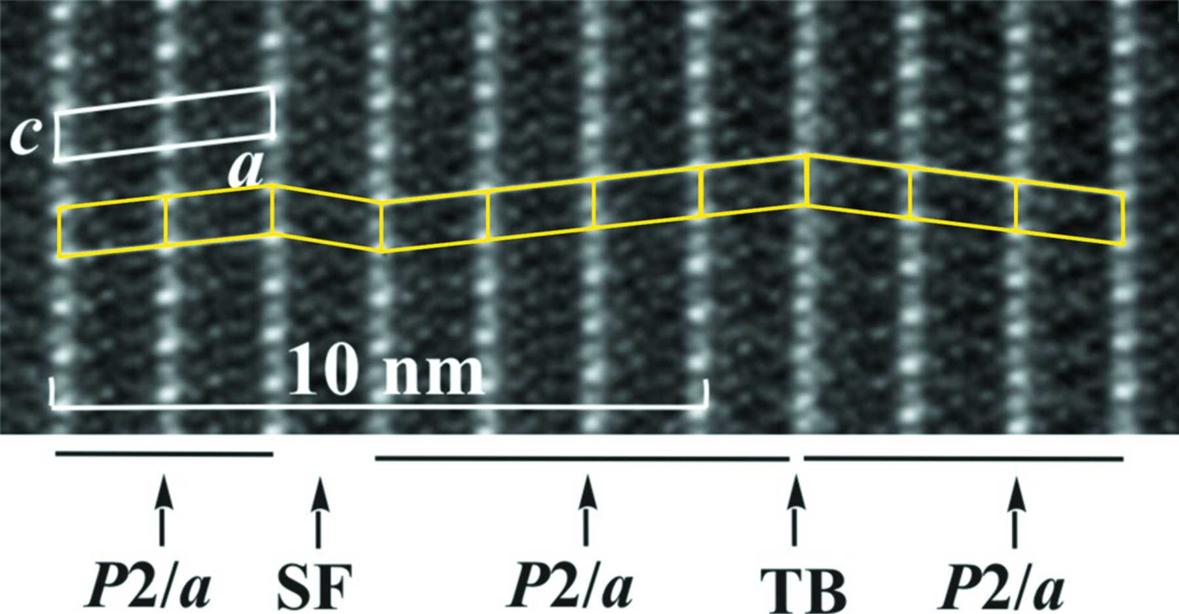
Figure 16. HRTEM of denisovite, showing ordered P12/a1 areas, a stacking fault (SF) and a twin boundary (TB). A unit cell is indicated in white, and the yellow rhomboids are a guide to the ...
Rozhdestvenskaya et al.
Volume 4 | Part 3 | May 2017 | Pages 223–242 | 10.1107/S2052252517002585
Notes:
HRTEM of denisovite, showing ordered P12/a1 areas, a stacking fault (SF) and a twin boundary (TB). A unit cell is indicated in white, and the yellow rhomboids are a guide to the eyes. [Rozhdestvenskaya, I. V., Mugnaioli, E., Schowalter, M., Schmidt, M. U., Czank, M., Depmeier, W. and Rosenauer, A. (2017). IUCrJ, 4, 223-242. 10.1107/S2052252517002585]

Slide 19
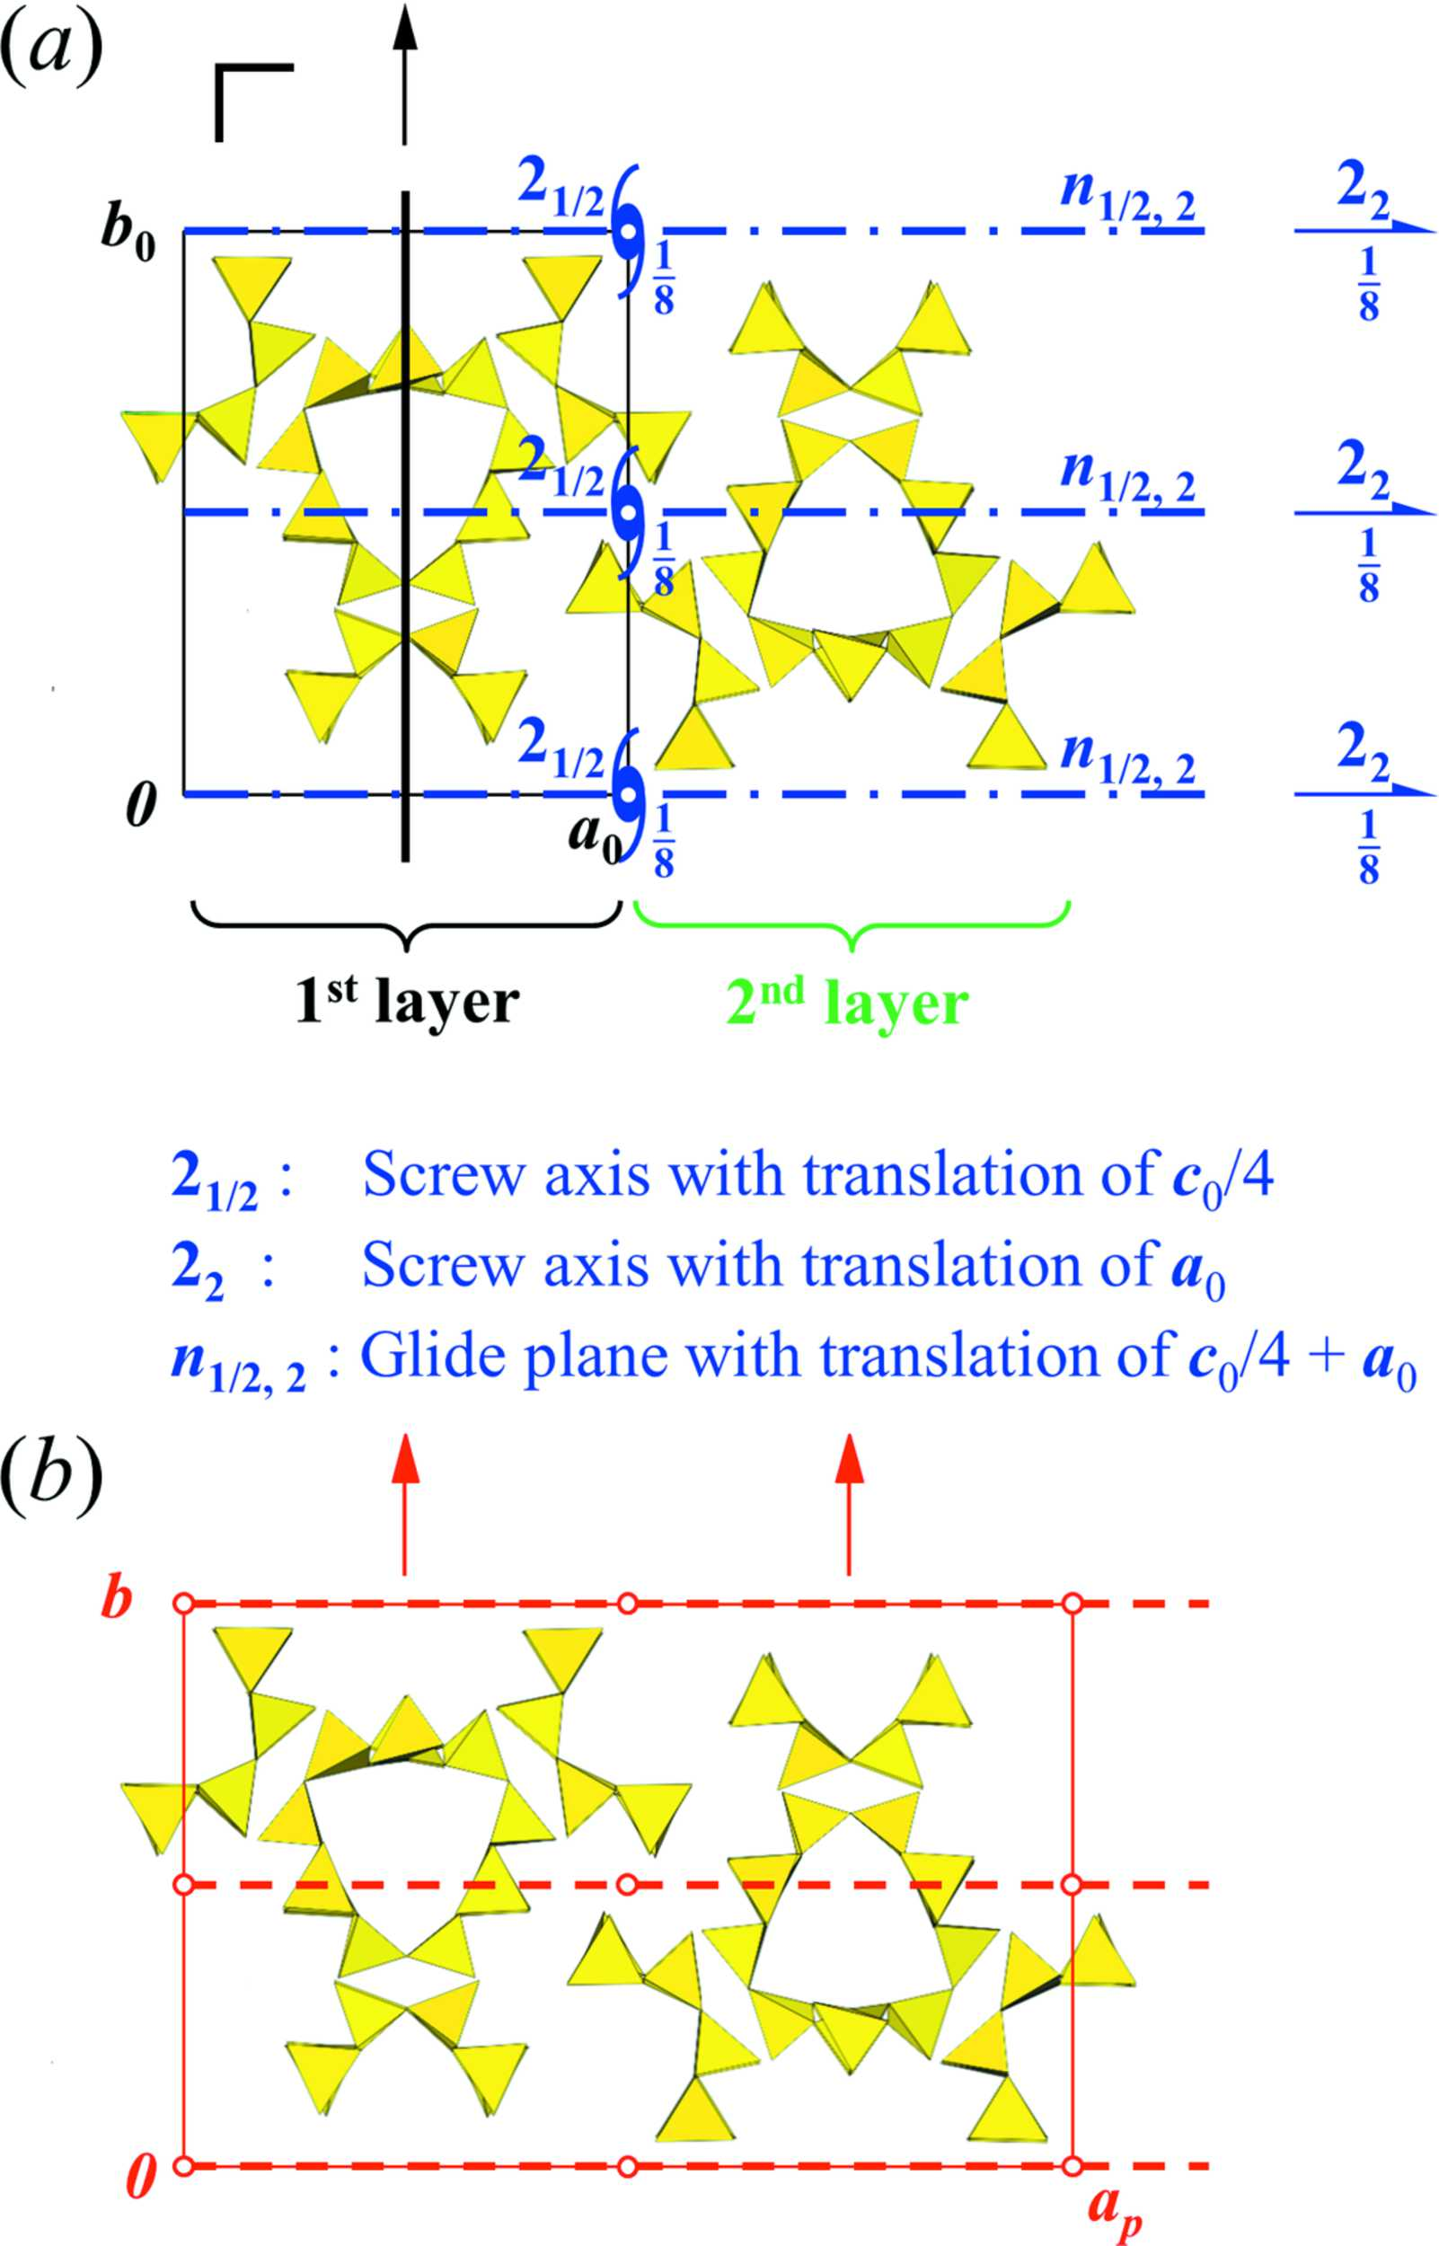
Figure 17. OD theory. (a) The symmetry elements of an isolated layer (first layer) are shown in black. The symmetry elements used to generate the second layer are shown in blue. The basis vectors ...
Rozhdestvenskaya et al.
Volume 4 | Part 3 | May 2017 | Pages 223–242 | 10.1107/S2052252517002585
Notes:
OD theory. (a) The symmetry elements of an isolated layer (first layer) are shown in black. The symmetry elements used to generate the second layer are shown in blue. The basis vectors of an isolated layer are a0, b0 and c0. The view is along c0. The figure displays the situation for a shift of c/4; in the case of a shift of −c/4, the z positions of all symmetry elements change from z to −z, the 21/2 axis changes to 2−1/2 with a translation of −c0/4, and the n1/2,2 glide plane converts to n−1/2,2 with a translation of a0 − c0/4. (b) Consecutive application of the shift of −c/4 leads to the ordered model structure MDO1 in P12/a1, which is the main structural motif of denisovite. All depicted symmetry elements (shown in red) are crystallographic ones. All other symmetry elements from panel (a) are still present, but they are only local symmetries within one layer (black) or between neighbouring layers (blue). The view is along [001]. Note that the a axis in P12/a1 is not parallel to a0, but a = 2a0 − c0/2. Thereby the n−1/2,2 glide plane changes to a proper a-glide plane. The subscript p in ap denotes the projection of the a axis. [Rozhdestvenskaya, I. V., Mugnaioli, E., Schowalter, M., Schmidt, M. U., Czank, M., Depmeier, W. and Rosenauer, A. (2017). IUCrJ, 4, 223-242. 10.1107/S2052252517002585]

