Slide 1
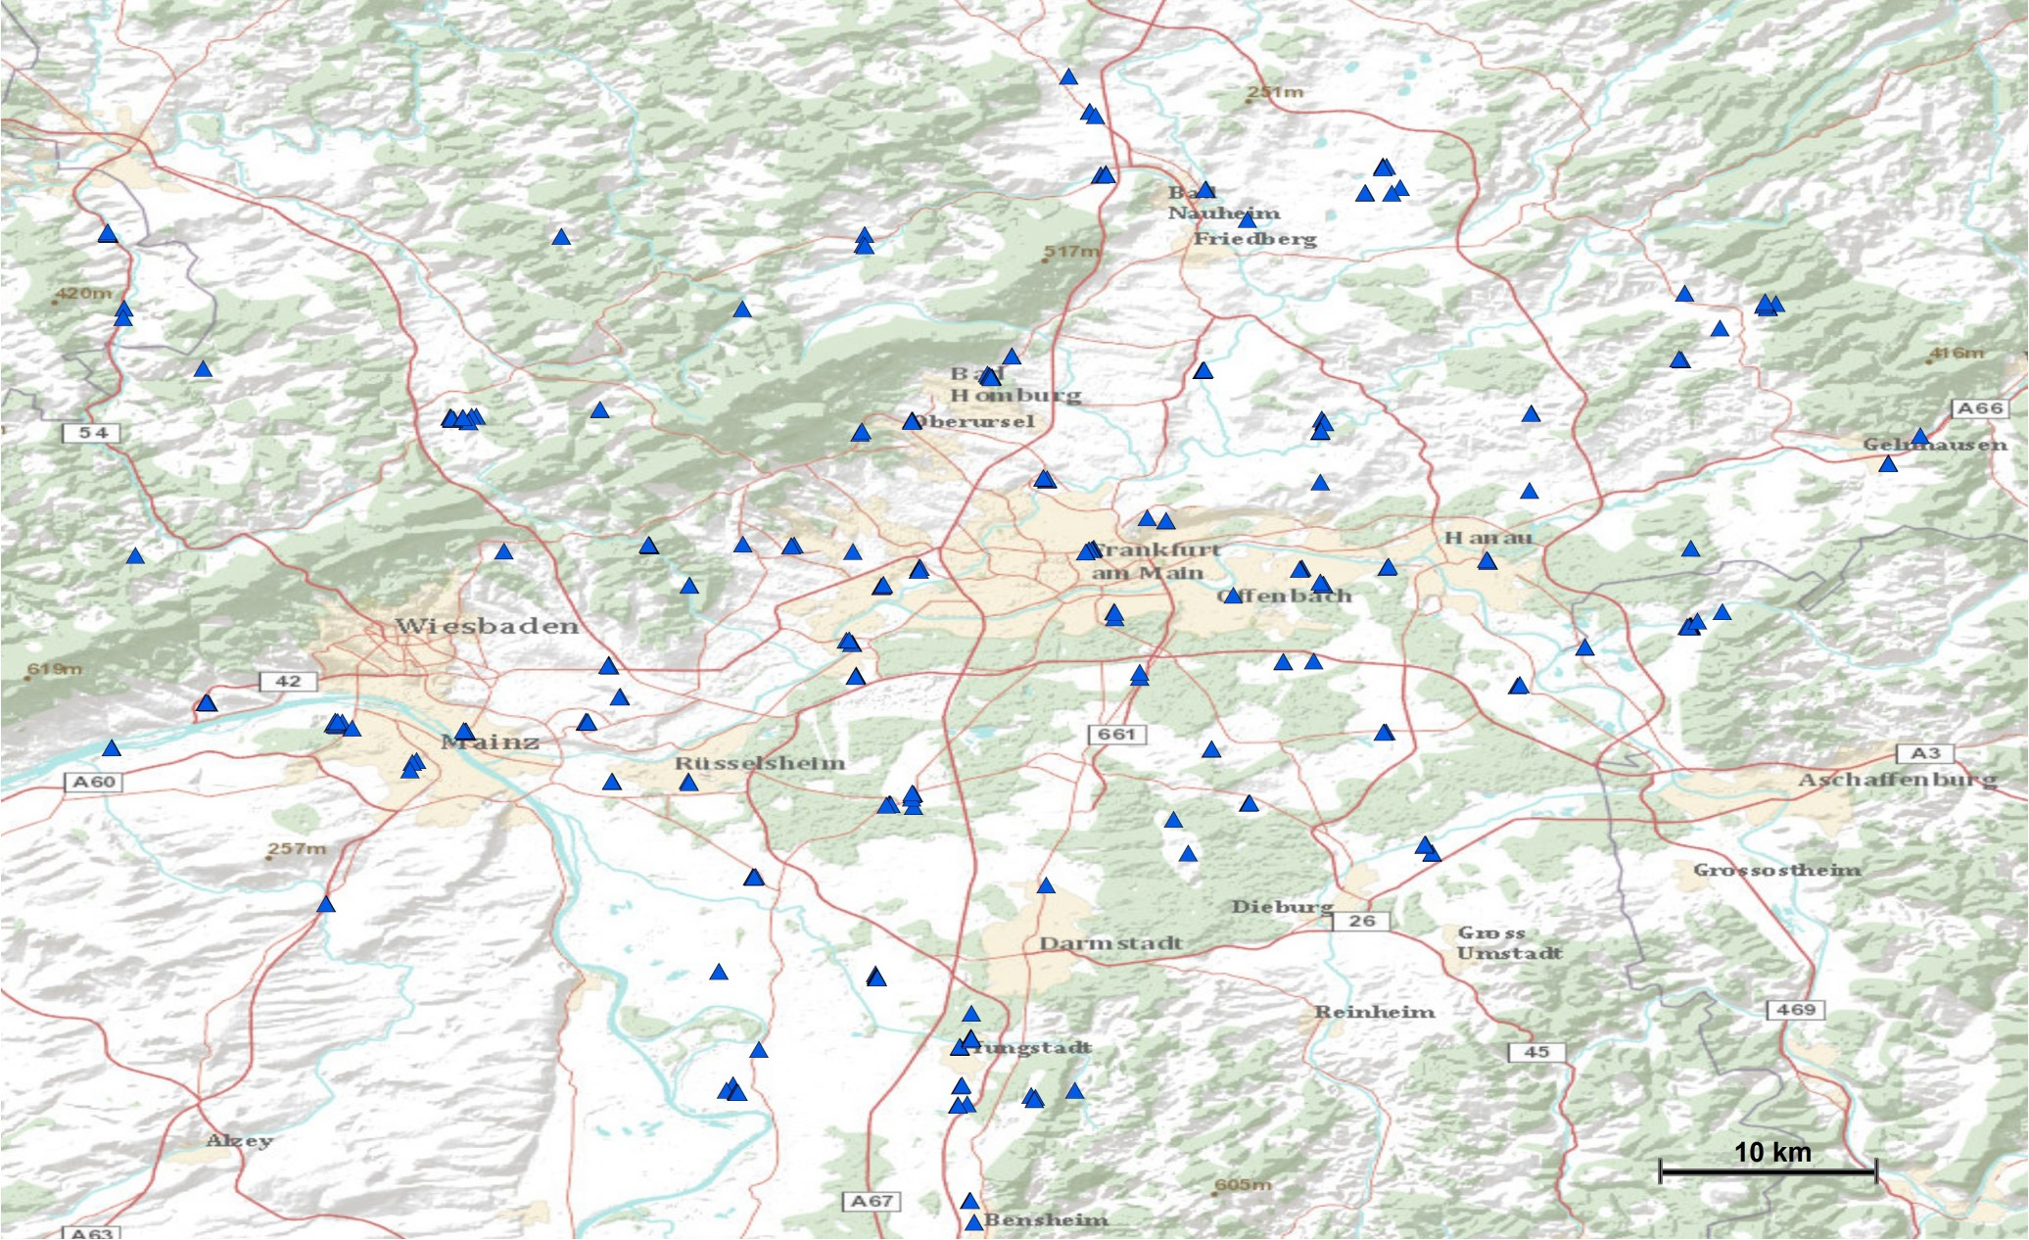
Additional file 1: Figure S1. Sampled localities positive for mosquito larvae in the Rhine-Main region.

