Slide 1
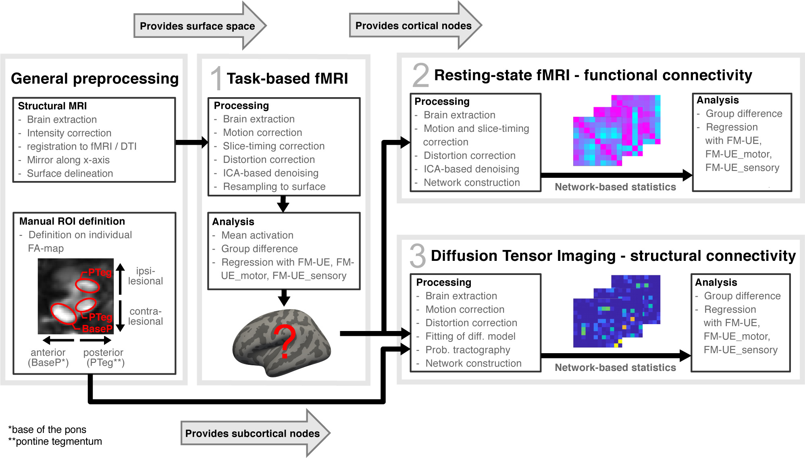
Functional redundancy of the premotor network in hemispherotomy patients
Ann Clin Transl Neurol, Volume: 8, Issue: 9, Pages: 1796-1808, First published: 04 August 2021, DOI: (10.1002/acn3.51427)
Notes:
Schematic of the 3 consecutive steps of imaging analysis applied. FA‐map, Fractional anisotropy map; FM‐UE_motor, Fugl‐Meyer motor score of the upper extremity; FM‐UE_sensory, Fugl‐Meyer sensory score of the upper extremity; ICA‐based denoising, independent component analysis‐based denoising.
IF THIS IMAGE HAS BEEN PROVIDED BY OR IS OWNED BY A THIRD PARTY, AS INDICATED IN THE CAPTION LINE, THEN FURTHER PERMISSION MAY BE NEEDED BEFORE ANY FURTHER USE. PLEASE CONTACT WILEY'S PERMISSIONS DEPARTMENT ON PERMISSIONS@WILEY.COM OR USE THE RIGHTSLINK SERVICE BY CLICKING ON THE 'REQUEST PERMISSIONS' LINK ACCOMPANYING THIS ARTICLE. WILEY OR AUTHOR OWNED IMAGES MAY BE USED FOR NON-COMMERCIAL PURPOSES, SUBJECT TO PROPER CITATION OF THE ARTICLE, AUTHOR, AND PUBLISHER.

