Slide 1
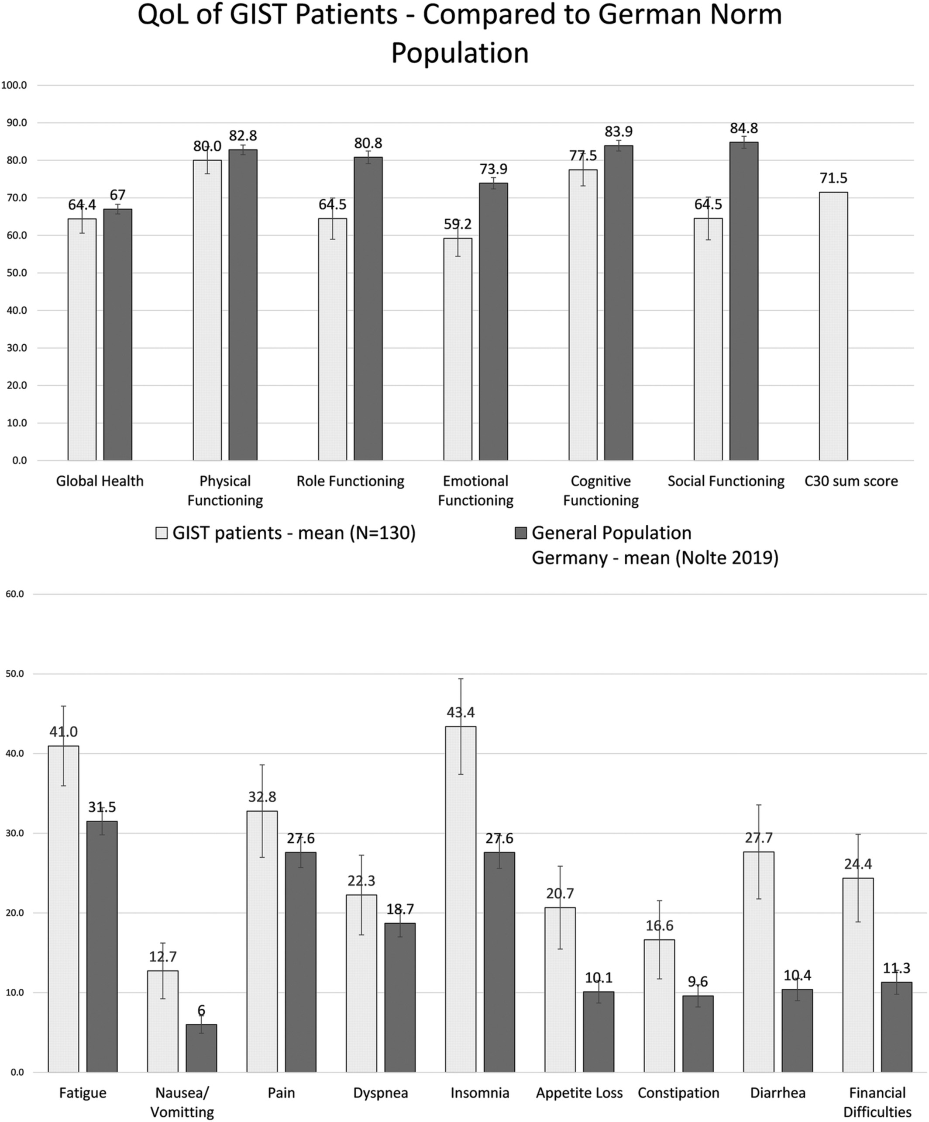
Quality of life of GIST patients with and without current tyrosine kinase inhibitor treatment: Cross‐sectional results of a German multicentre observational study (PROSa)
European J Cancer Care, Volume: 30, Issue: 6, First published: 03 August 2021, DOI: (10.1111/ecc.13484)
Notes:
Age and sex standardised comparison to a German norm population (Nolte et al., 2019). C30 sum score not standardised and without comparable data. ↕ 95% confidence interval. Large differences: Social functioning, Diarrhoea; medium/moderate differences: Financial difficulties, emotional functioning, insomnia; small differences: Role functioning, cognitive functioning, fatigue, nausea/vomiting, appetite loss, constipation; trivial differences: Global Health, physical functioning, pain, dyspnea
IF THIS IMAGE HAS BEEN PROVIDED BY OR IS OWNED BY A THIRD PARTY, AS INDICATED IN THE CAPTION LINE, THEN FURTHER PERMISSION MAY BE NEEDED BEFORE ANY FURTHER USE. PLEASE CONTACT WILEY'S PERMISSIONS DEPARTMENT ON PERMISSIONS@WILEY.COM OR USE THE RIGHTSLINK SERVICE BY CLICKING ON THE 'REQUEST PERMISSIONS' LINK ACCOMPANYING THIS ARTICLE. WILEY OR AUTHOR OWNED IMAGES MAY BE USED FOR NON-COMMERCIAL PURPOSES, SUBJECT TO PROPER CITATION OF THE ARTICLE, AUTHOR, AND PUBLISHER.

