Slide 1
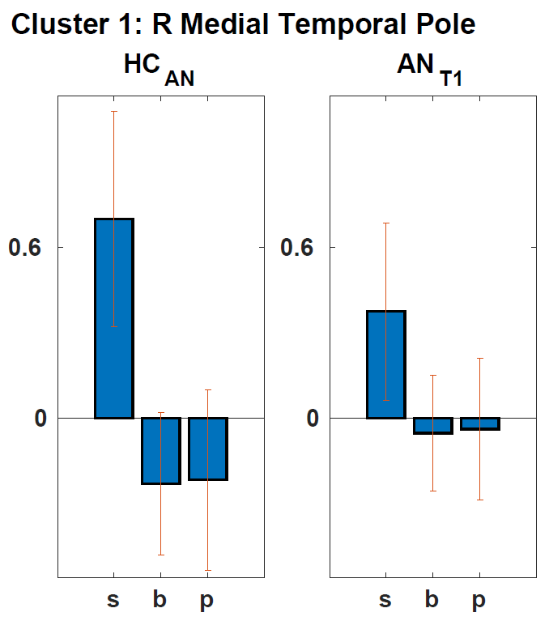
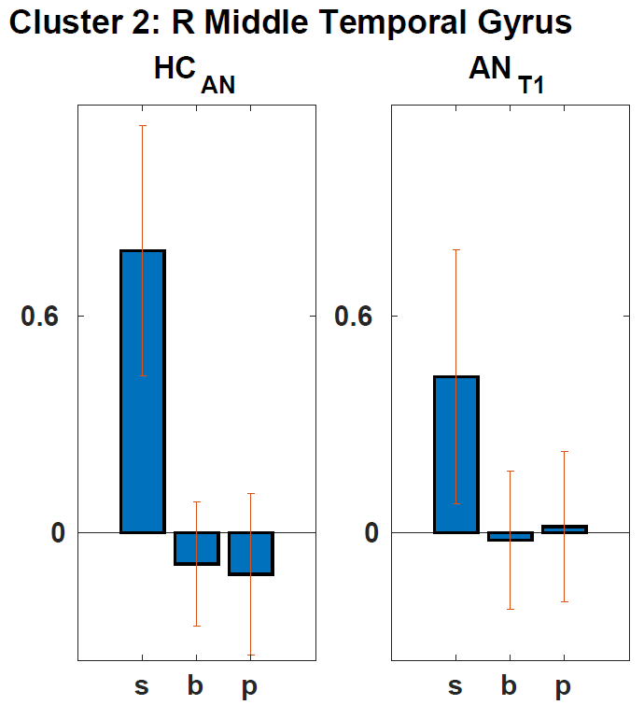
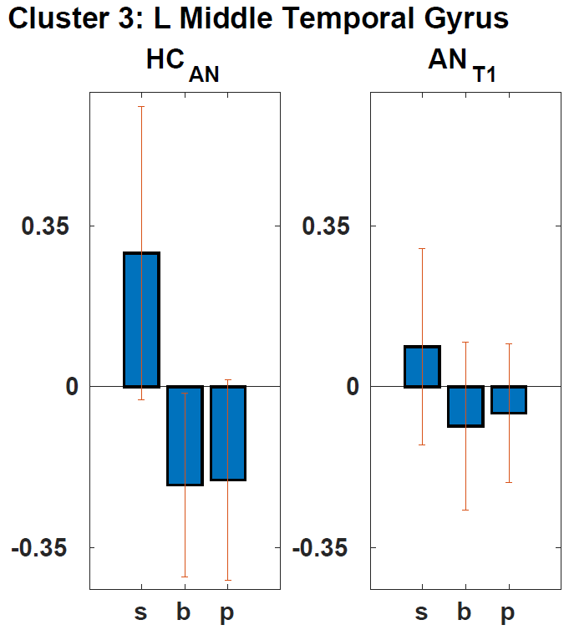
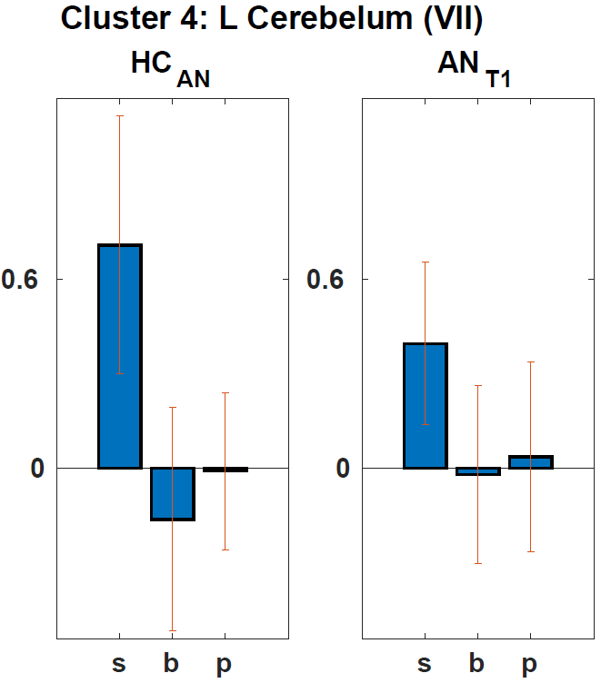
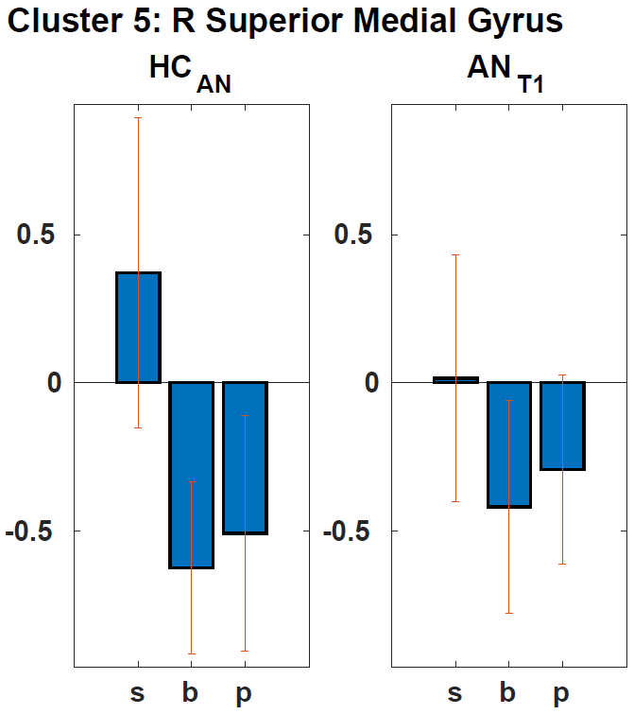
Sup Fig 1 HC_{AN}> AN_{T1}
Notes:
Sup Fig 1 Hypoactivity in acutely ill patients with AN: AN_{T1} vs HC_{AN} (ToM vs non-ToM) of significant clusters of the whole brain analysis, FWE corrected p<0.05. Here, p<0.001 uncorrected is used for display purposes. Beta-plots of all significant clusters include separate mean beta scores for both groups and s (social), b (bumper) and p (physical) respectively. Greater activation for social compared to bumper and physical (ToM vs non-ToM) supports regions being part of the ToM-network depicted in figure 1.

Slide 2
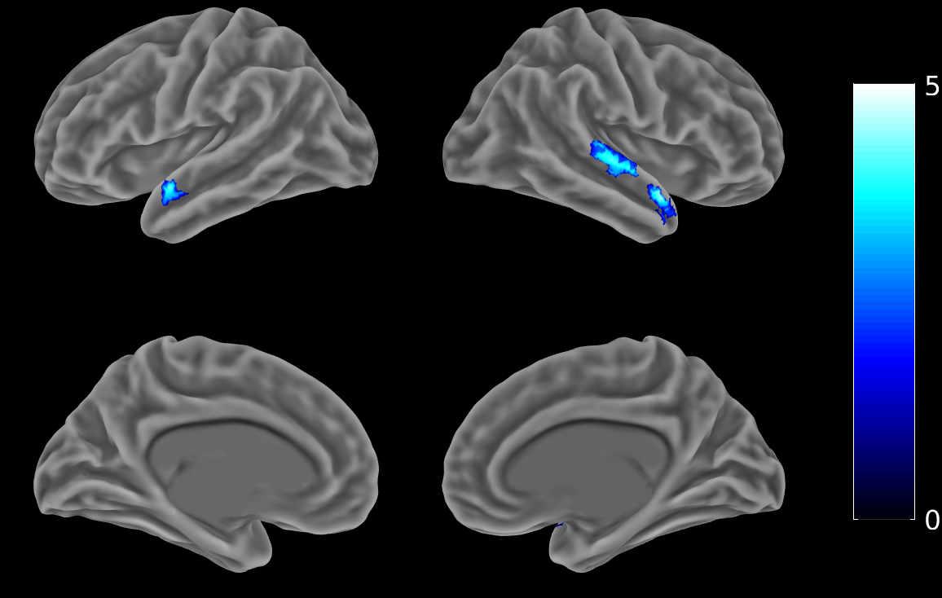
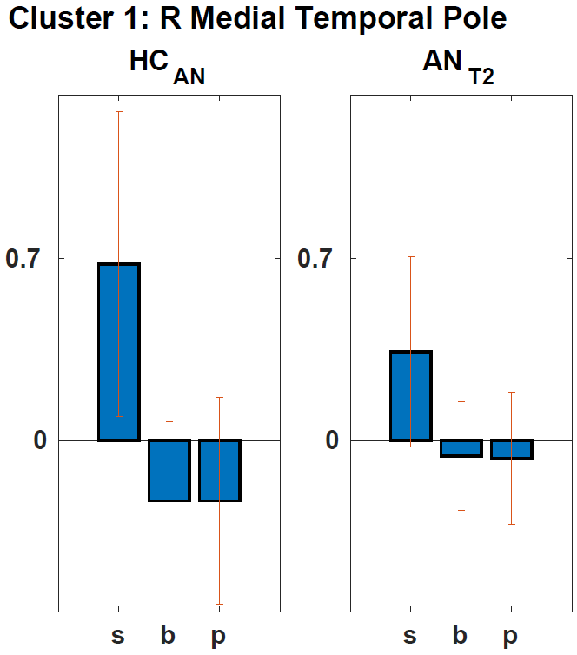
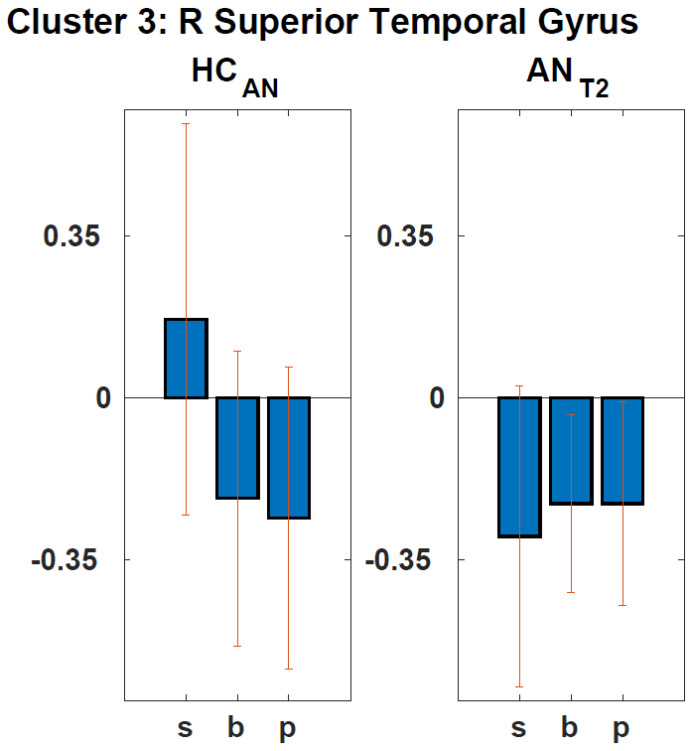
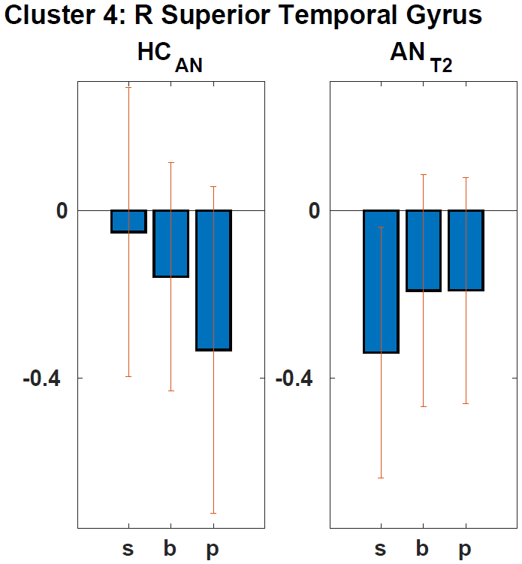
Sup Fig 2 HC_{AN}> AN_{T2}
Notes:
Sup Fig 2 Hypoactivity in short term weight restored patients with AN: AN_{T2} vs HC_{AN} (ToM vs non-ToM) of significant clusters of the whole brain analysis, FWE corrected p<0.05. Here, p<0.001 uncorrected is used for display purposes. Beta-plots of all significant clusters include separate mean beta scores for both groups and s (social), b (bumper) and p (physical) respectively. Greater activation for social compared to bumper and physical (ToM vs non-ToM) supports regions being part of the ToM-network depicted in figure 1.

Slide 3
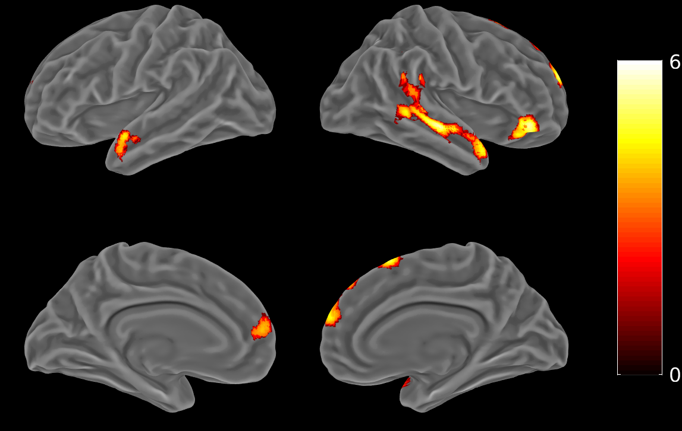
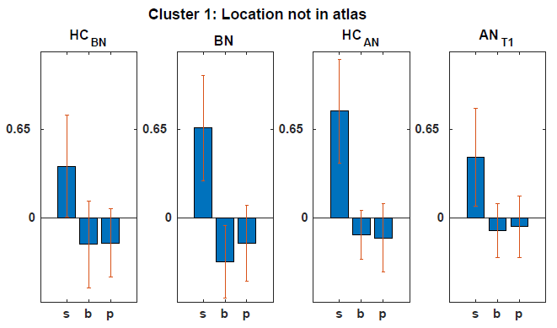
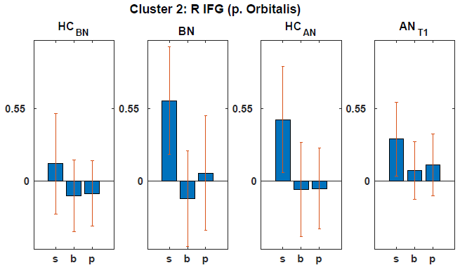
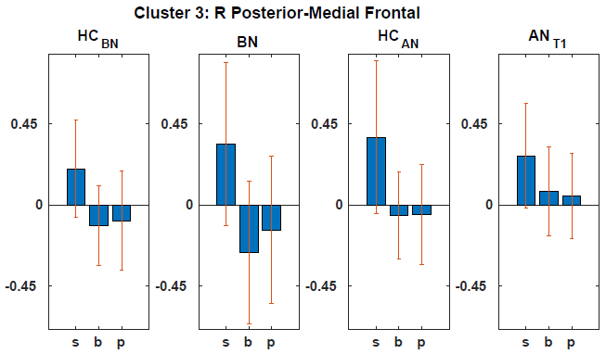
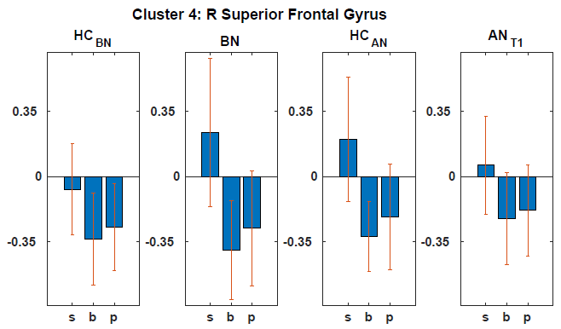
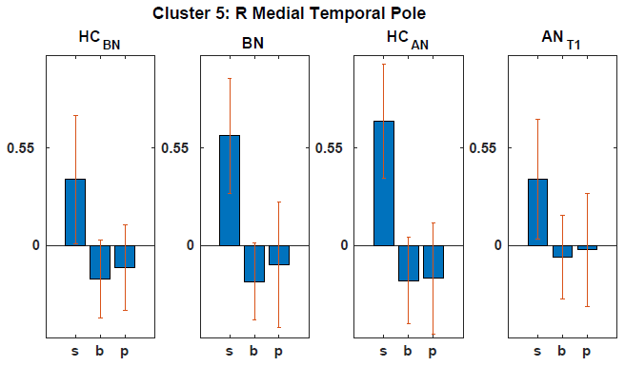
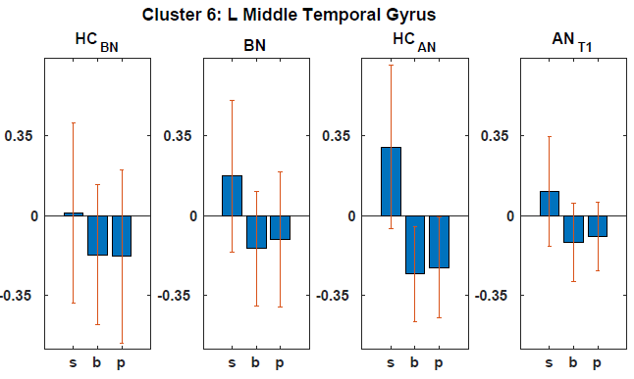
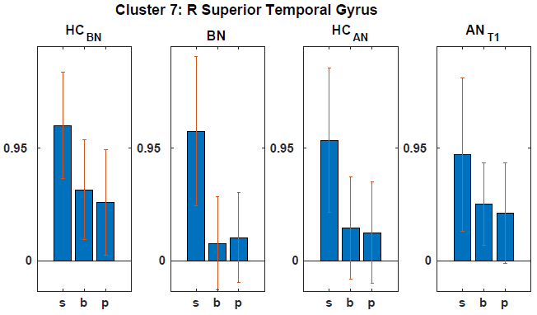
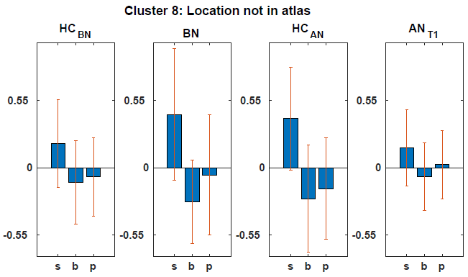
Sup Fig 3 BN-HC_{BN} > AN_{T1}-HC_{AN}
Notes:
Sup Fig 3 Direct comparison of BN and acutely ill AN (including their respective controls): Positive Contrast BN>HC_{BN} vs AN_{T1} >HC_{AN} (ToM vs non-ToM) of significant clusters of the whole brain analysis, FWE corrected p<0.05. Here, p<0.001 uncorrected is used for display purposes. Beta-plots of all significant clusters include separate mean beta scores for both groups and s (social), b (bumper) and p (physical) respectively. Greater activation for social compared to bumper and physical (ToM vs non-ToM) supports regions being part of the ToM-network depicted in figure 1.

Slide 4
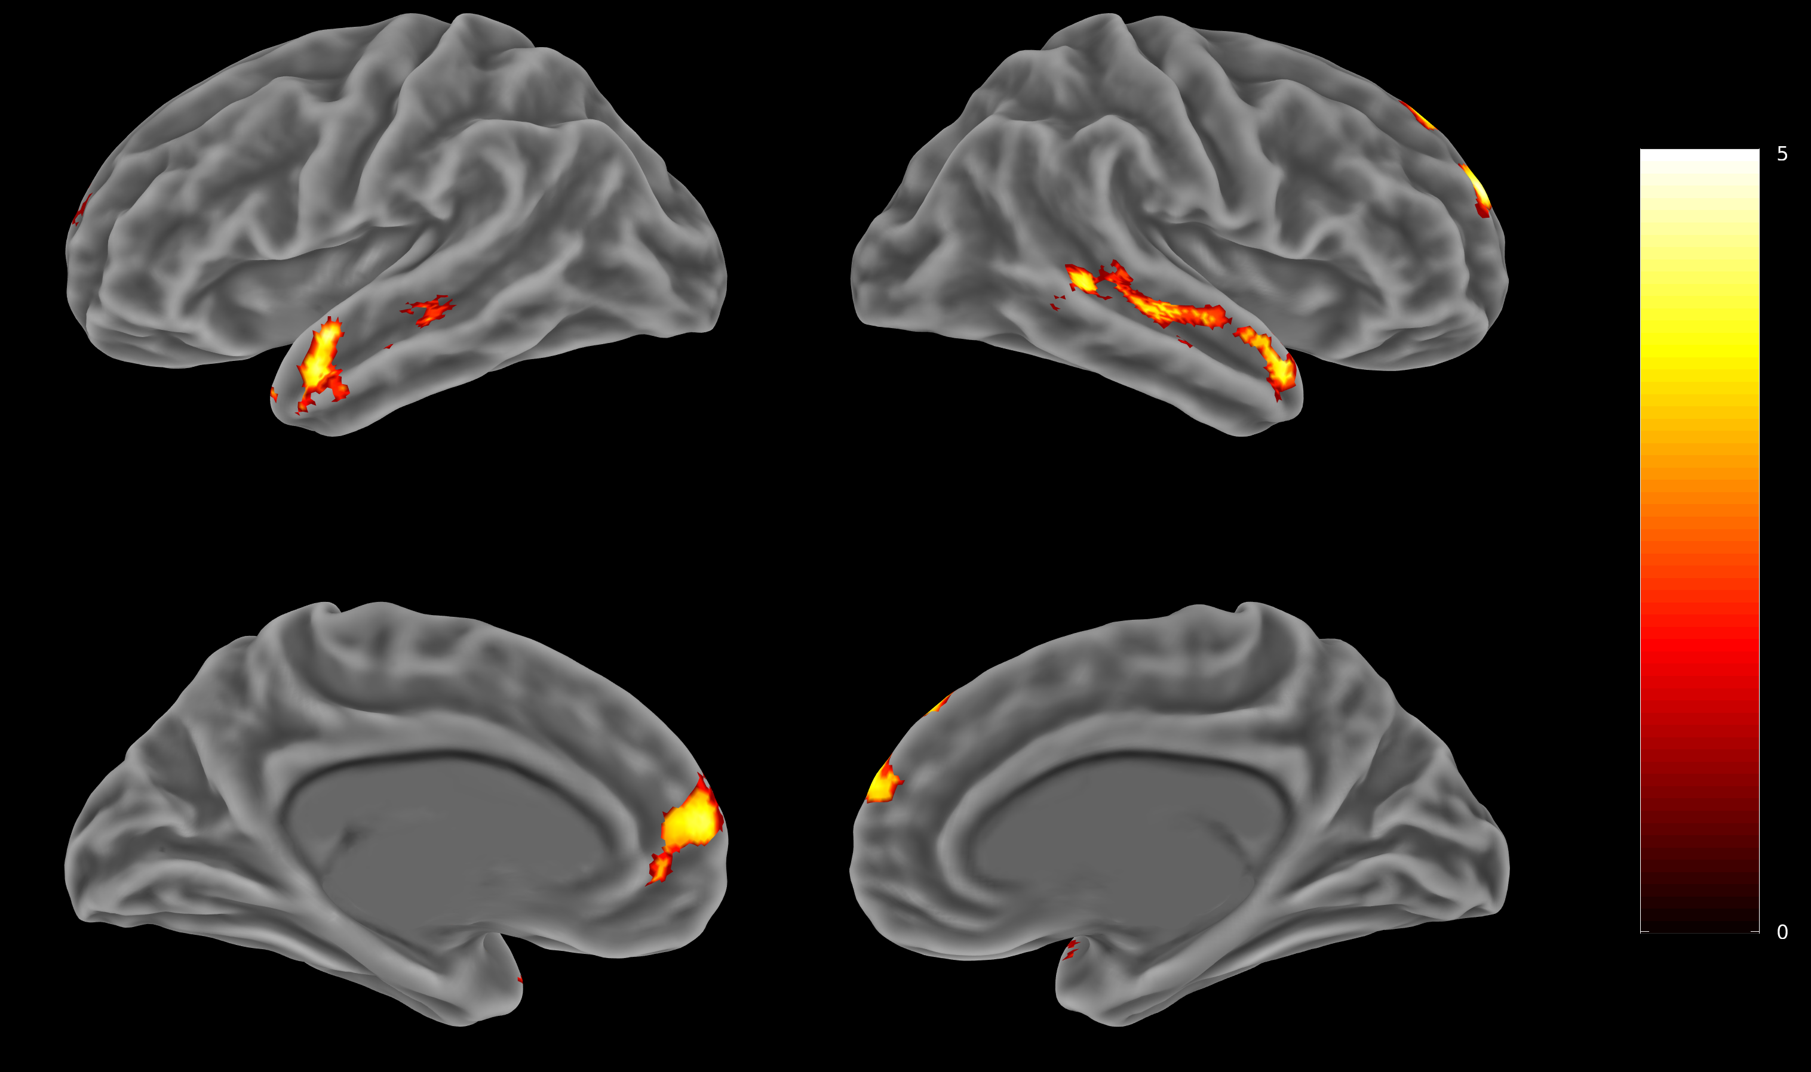
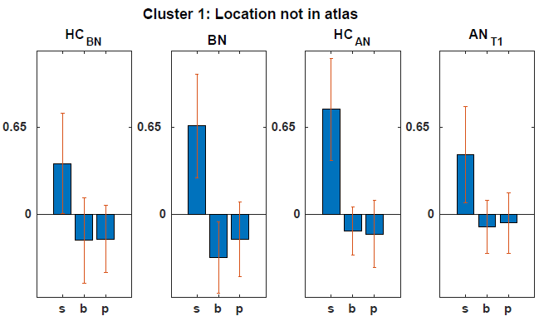
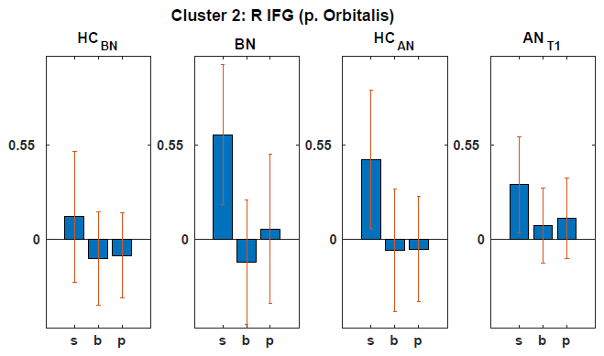
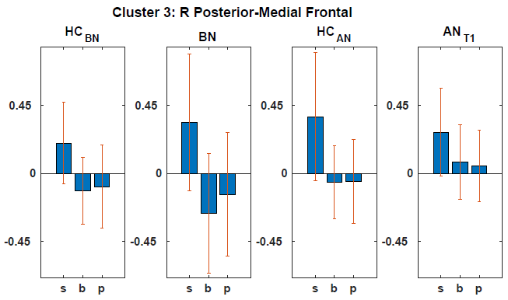
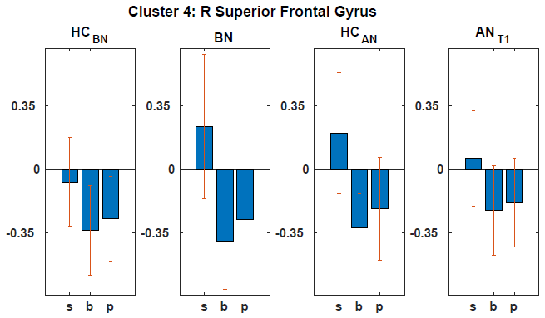
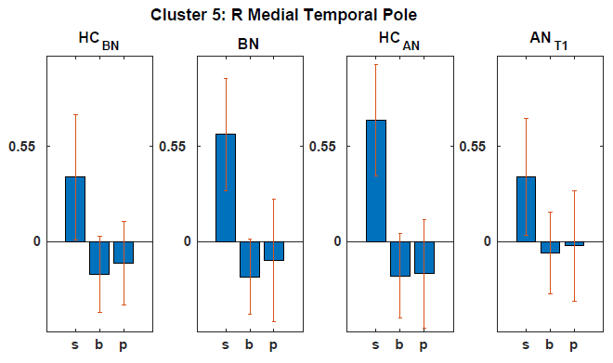
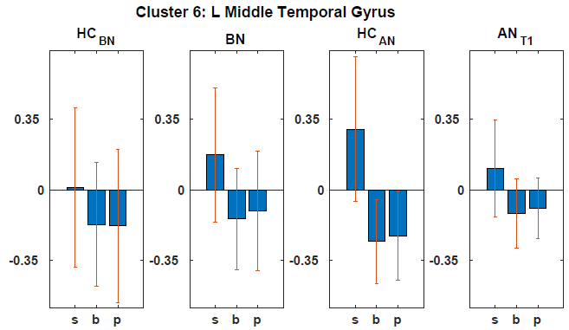
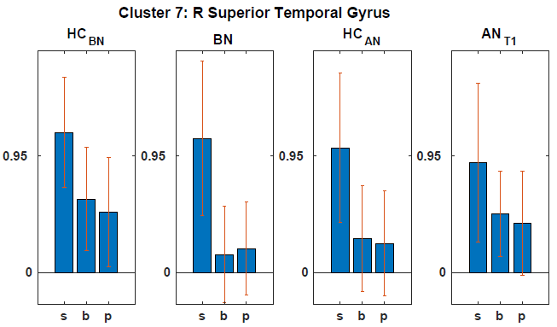
Sup Fig 4 BN-HC_{BN} > AN_{T2}-HC_{AN}
Notes:
Sup Fig 4 Direct comparison of BN and short time weight restored AN (including their respective controls): Positive Contrast BN>HC_{BN} vs AN_{T2} >HC_{AN} (ToM vs non-ToM) of significant clusters of the whole brain analysis, FWE corrected p<0.05. Here, p<0.001 uncorrected is used for display purposes. Beta-plots of all significant clusters include separate mean beta scores for both groups and s (social), b (bumper) and p (physical) respectively. Greater activation for social compared to bumper and physical (ToM vs non-ToM) supports regions being part of the ToM-network depicted in figure 1.

Slide 5
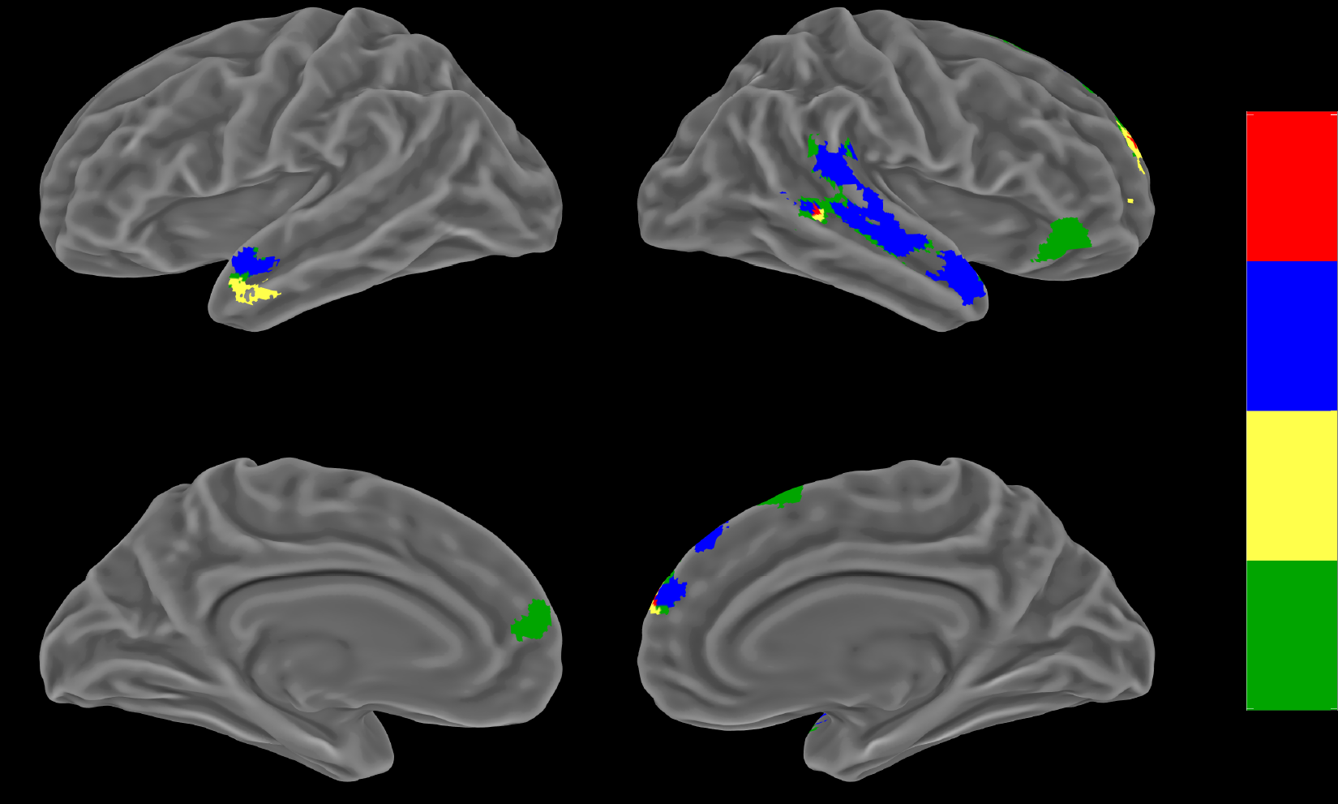
Sup Fig 5 Joint overlay BN and AN_{T1}
BN>HC_{BN}
HC_{AN}>AN_{T1}
HC_{AN}>AN_{T1}
BN>HC_{BN}
BN>AN_{T1}
Notes:
Sup Fig 5 Overlay demonstrating close proximity of hyper- and hypoactive regions. BN>HC_{BN} in yellow, HC_{AN}>AN_{T1} in blue, both BN>HC_{BN} and HC_{AN}>AN_{T1} in red, BN>AN_{T1} (including respective HC) not overlapping with the first two in green. Significant clusters of the whole brain analysis, FWE corrected p<0.05. Here, p<0.001 uncorrected is used for display purposes only.

Slide 6
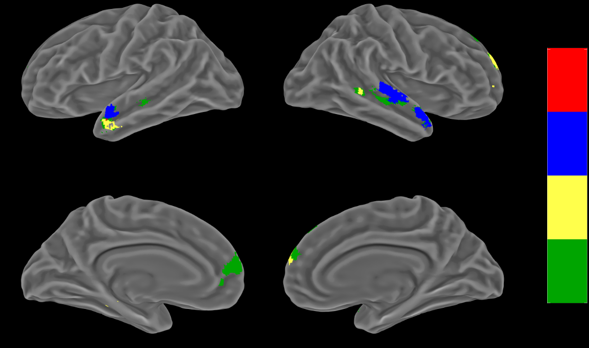
Sup Fig 6 Joint overlay BN and AN_{T2}
BN>HC_{BN}
HC_{AN}>AN_{T2}
HC_{AN}>AN_{T2}
BN>HC_{BN}
BN>AN_{T2}
Notes:
Sup Fig 6 Overlay demonstrating close proximity of hyper- and hypoactive regions. BN>HC_{BN} in yellow, HC_{AN}>AN_{T2} in blue, both BN>HC_{BN} and HC_{AN}>AN_{T2} in red, BN>AN_{T2} (including respective HC) not overlapping with the first two in green. Significant clusters of the whole brain analysis, FWE corrected p<0.05. Here p<0.001 uncorrected is used for display purposes only.

Slide 7
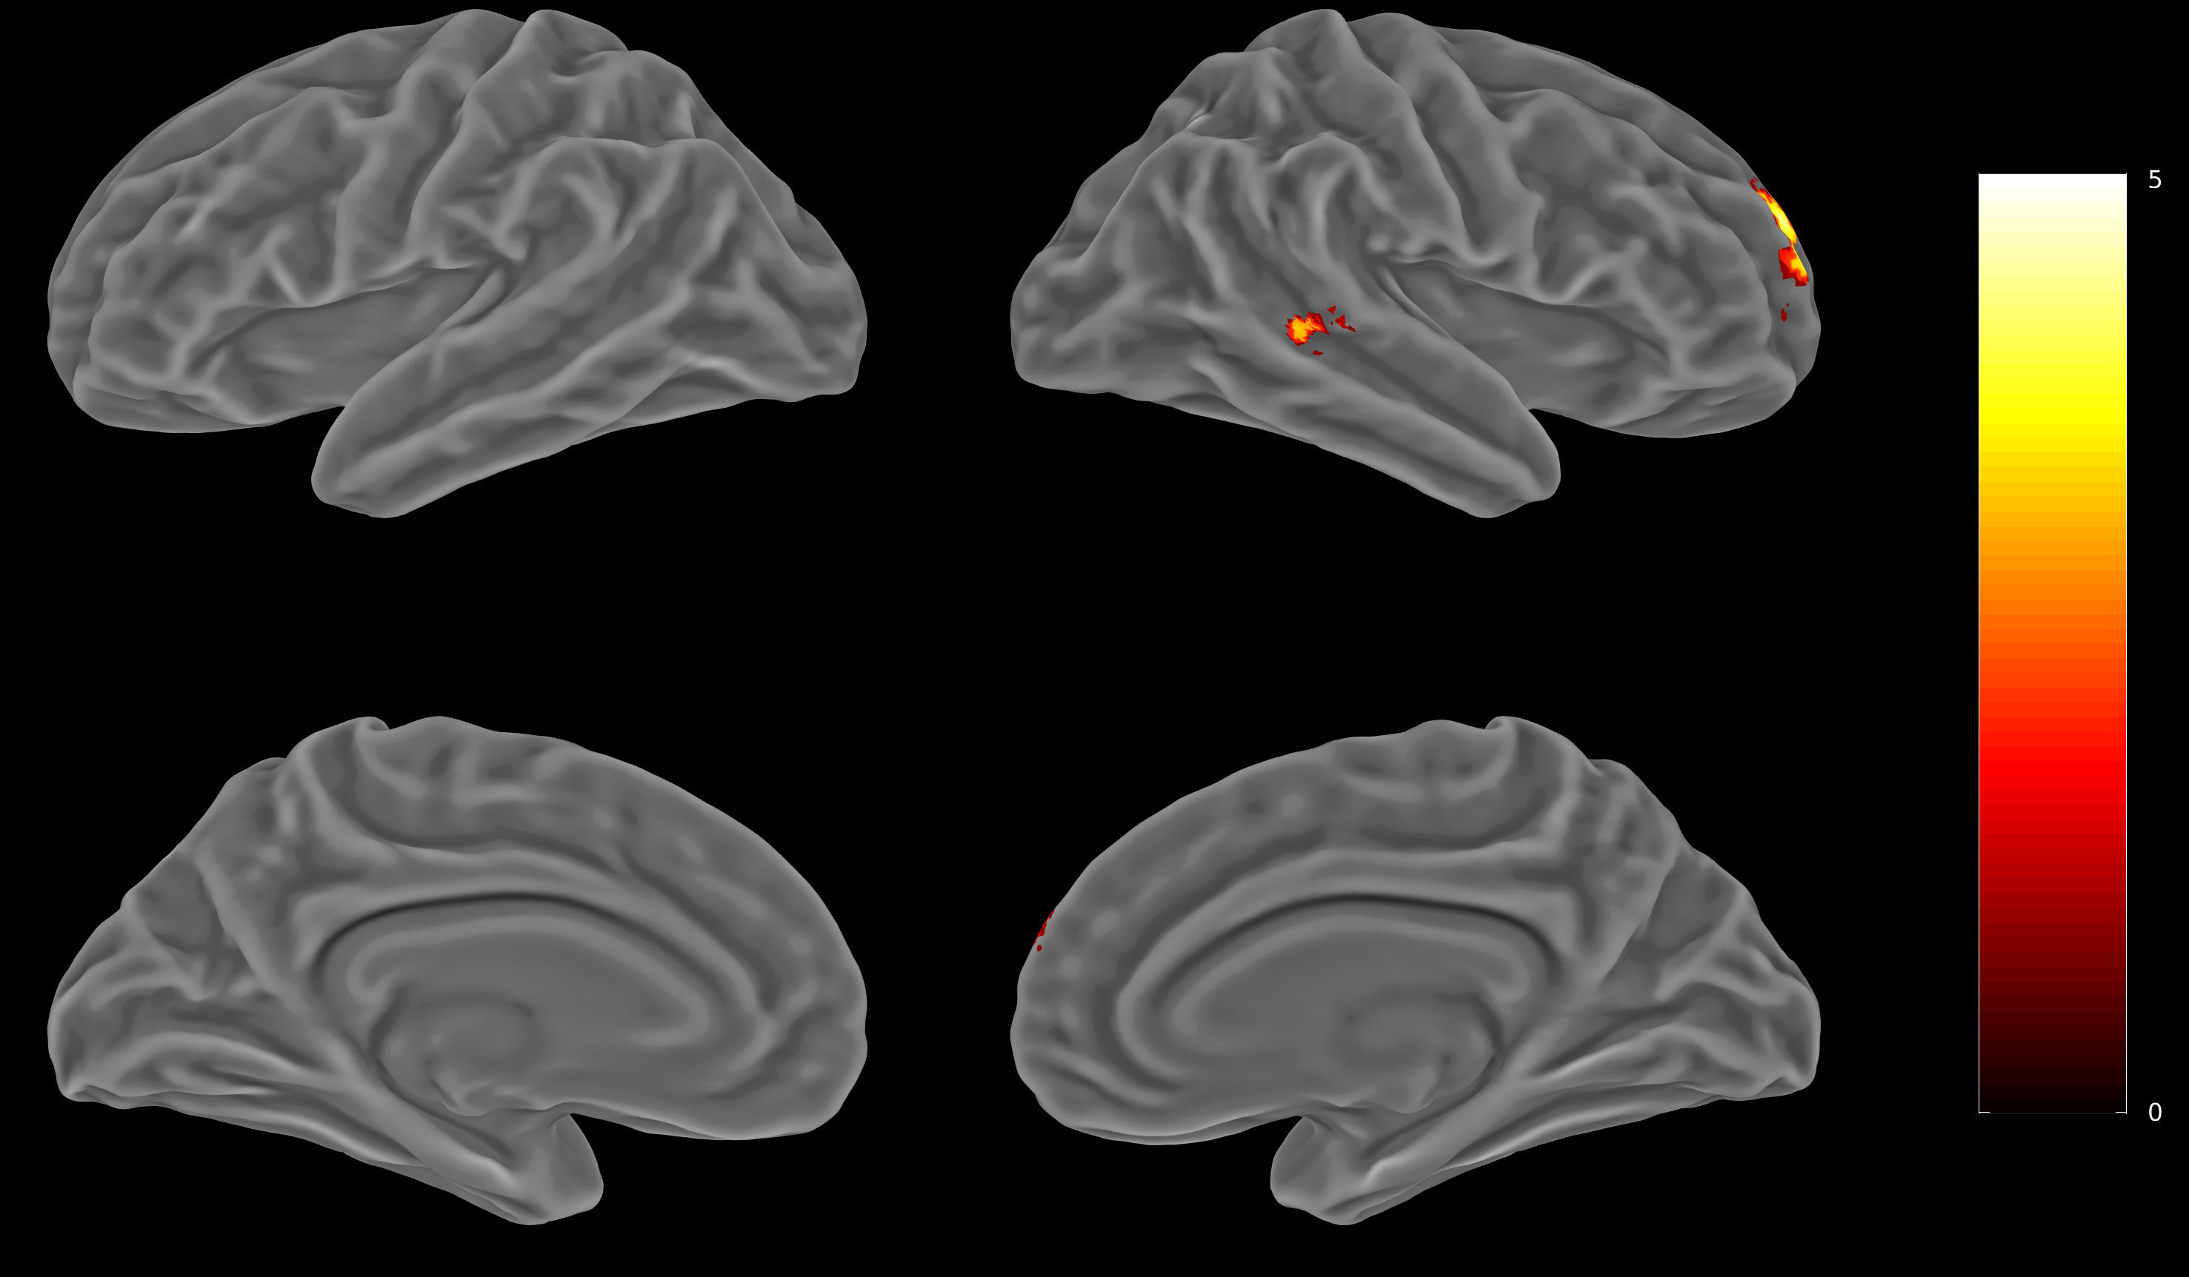
Sup Fig 7 BN>HC_{BN} (no SSRI)
Notes:
Sup Fig 7 Direct comparison of BN and short time weight restored AN (including their respective controls): Positive Contrast BN>HC_{BN} vs AN_{T2} >HC_{AN} (ToM vs non-ToM) of significant clusters of the whole brain analysis, FWE corrected p<0.05. Here, p<0.001 uncorrected is used for display purposes. Beta-plots of all significant clusters include separate mean beta scores for both groups and s (social), b (bumper) and p (physical) respectively. Greater activation for social compared to bumper and physical (ToM vs non-ToM) supports regions being part of the ToM-network depicted in figure 1.

Slide 8
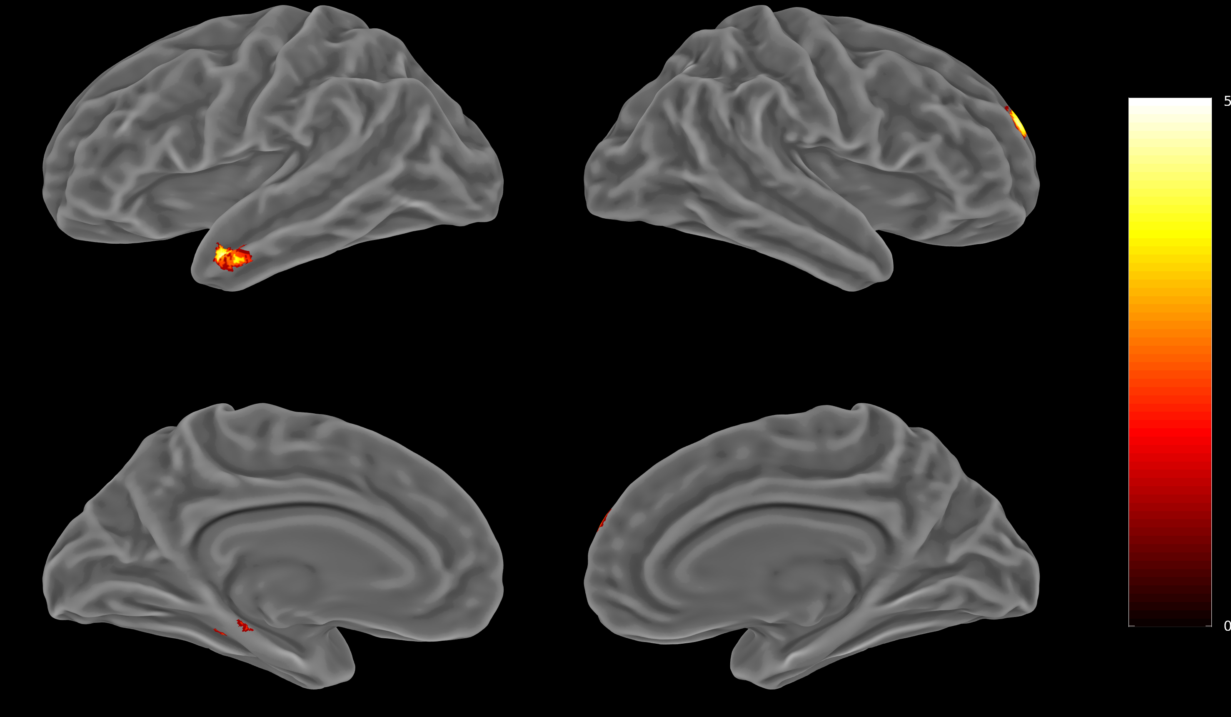
Sup Fig 8 BN>HC_{BN} (no major depression)
Notes:
Sup Fig 8 Direct comparison of BN and short time weight restored AN (including their respective controls): Positive Contrast BN>HC_{BN} vs AN_{T2} >HC_{AN} (ToM vs non-ToM) of significant clusters of the whole brain analysis, FWE corrected p<0.05. Here, p<0.001 uncorrected is used for display purposes. Beta-plots of all significant clusters include separate mean beta scores for both groups and s (social), b (bumper) and p (physical) respectively. Greater activation for social compared to bumper and physical (ToM vs non-ToM) supports regions being part of the ToM-network depicted in figure 1.

Slide 9
Sup Fig 9 BN-HC_{BN} > AN_{T1}-HC_{AN} (age corrected)
5
Notes:
Sup Fig 9 Direct comparison of BN and acutely ill AN (including their respective controls): Positive Contrast BN>HC_{BN} vs AN_{T1} >HC_{AN} (ToM vs non-ToM) of significant clusters of the whole brain analysis, FWE corrected p<0.05. Here, p<0.001 uncorrected is used for display purposes. Beta-plots of all significant clusters include separate mean beta scores for both groups and s (social), b (bumper) and p (physical) respectively. Greater activation for social compared to bumper and physical (ToM vs non-ToM) supports regions being part of the ToM-network depicted in figure 1.

Slide 10
Sup Fig 10 BN-HC_{BN} > AN_{T2}-HC_{AN} (age corrected)
Notes:
Sup Fig 10 Direct comparison of BN and short time weight restored AN (including their respective controls): Positive Contrast BN>HC_{BN} vs ANT2 >HC_{AN} (ToM vs non-ToM) of significant clusters of the whole brain analysis, FWE corrected p<0.05. Here, p<0.001 uncorrected is used for display purposes. Beta-plots of all significant clusters include separate mean beta scores for both groups and s (social), b (bumper) and p (physical) respectively. Greater activation for social compared to bumper and physical (ToM vs non-ToM) supports regions being part of the ToM-network depicted in figure 1.

