Slide 1
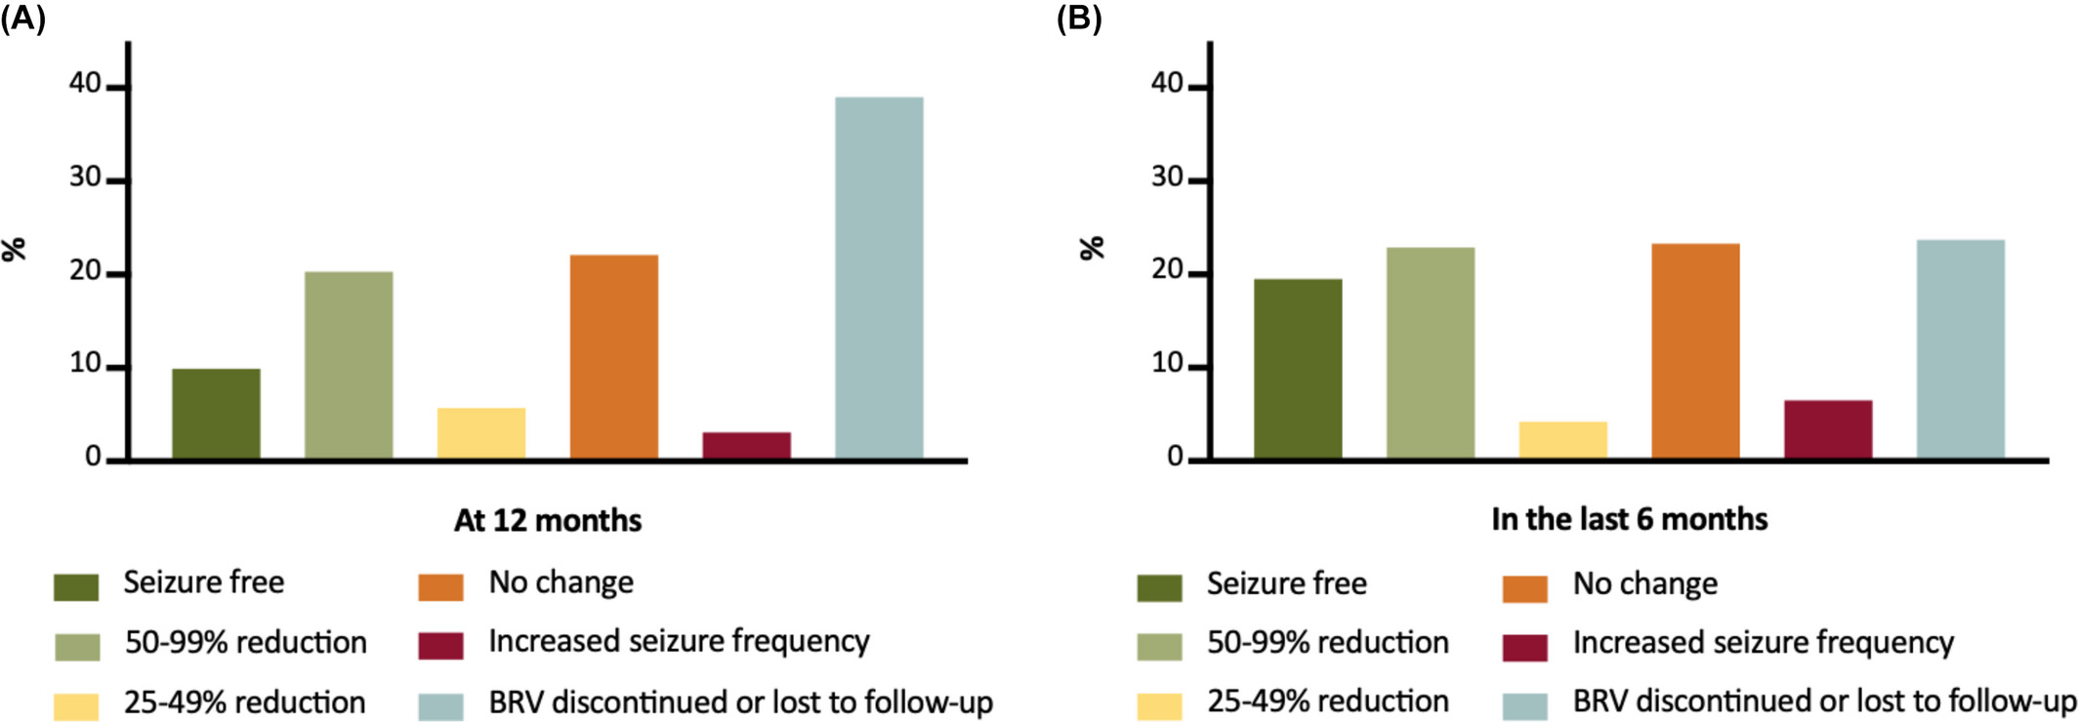
Long‐term efficacy, tolerability, and retention of brivaracetam in epilepsy treatment: A longitudinal multicenter study with up to 5 years of follow‐up
Epilepsia, First published: 04 October 2021, DOI: (10.1111/epi.17087)
Notes:
Seizure outcomes at 12 months (A) and during the last 6 months of follow‐up (B).
IF THIS IMAGE HAS BEEN PROVIDED BY OR IS OWNED BY A THIRD PARTY, AS INDICATED IN THE CAPTION LINE, THEN FURTHER PERMISSION MAY BE NEEDED BEFORE ANY FURTHER USE. PLEASE CONTACT WILEY'S PERMISSIONS DEPARTMENT ON PERMISSIONS@WILEY.COM OR USE THE RIGHTSLINK SERVICE BY CLICKING ON THE 'REQUEST PERMISSIONS' LINK ACCOMPANYING THIS ARTICLE. WILEY OR AUTHOR OWNED IMAGES MAY BE USED FOR NON-COMMERCIAL PURPOSES, SUBJECT TO PROPER CITATION OF THE ARTICLE, AUTHOR, AND PUBLISHER.

